Slide 1
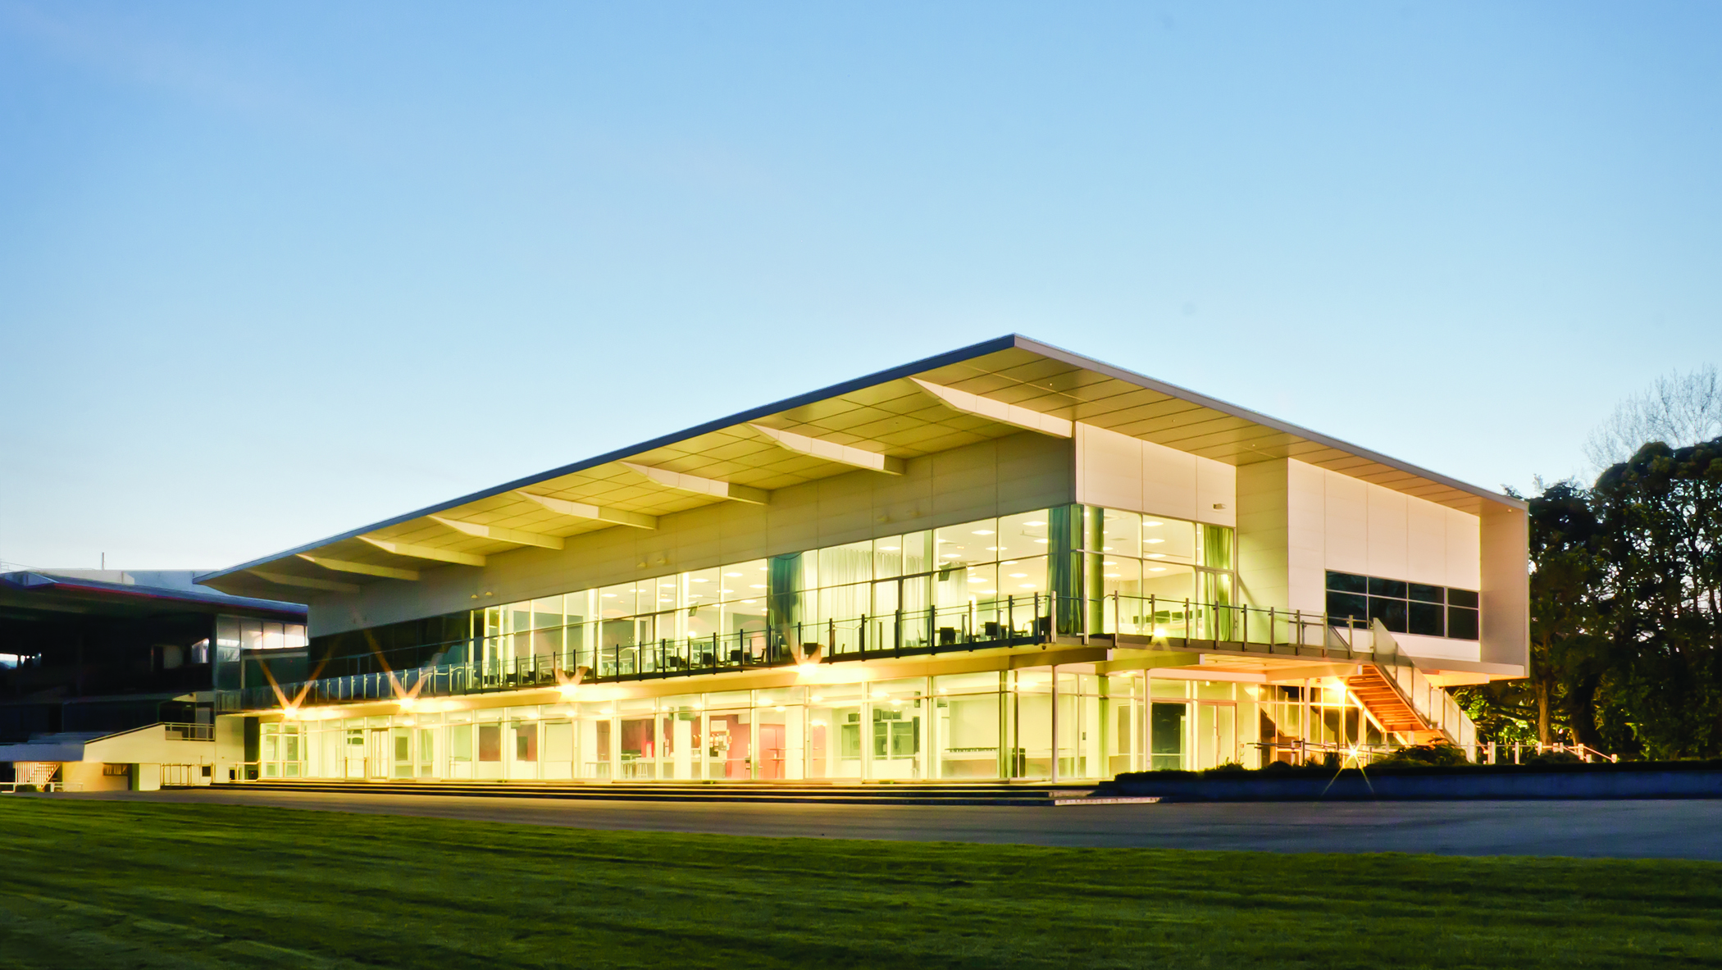
Menu pack

Slide 2
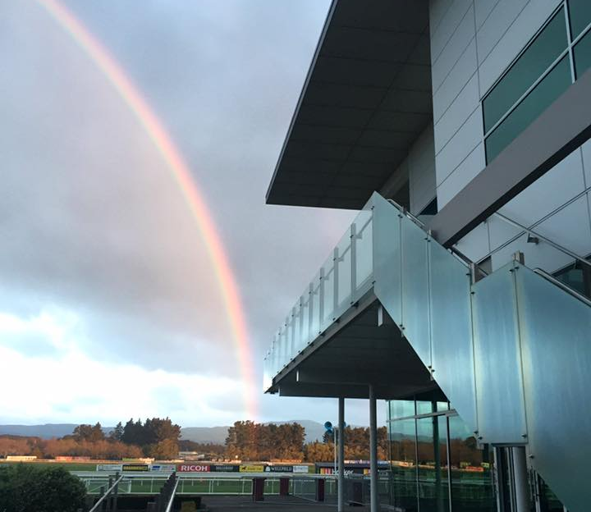
The Awapuni Function Centre is based at the Awapuni Racecourse in Palmerston North.
Centrally located with ample free car parking and green space, the Awapuni Function Centre is purpose built to step up to any occasion. Whether you are organising a board meeting, management conference, training day or an event such as a dinner, product launch or a trade show we can accommodate it all.
Set in park like surroundings and with spectacular views over to the Tararuas and the wind farm, the Awapuni Function Centre offers a unique venue for your next event.

Slide 3
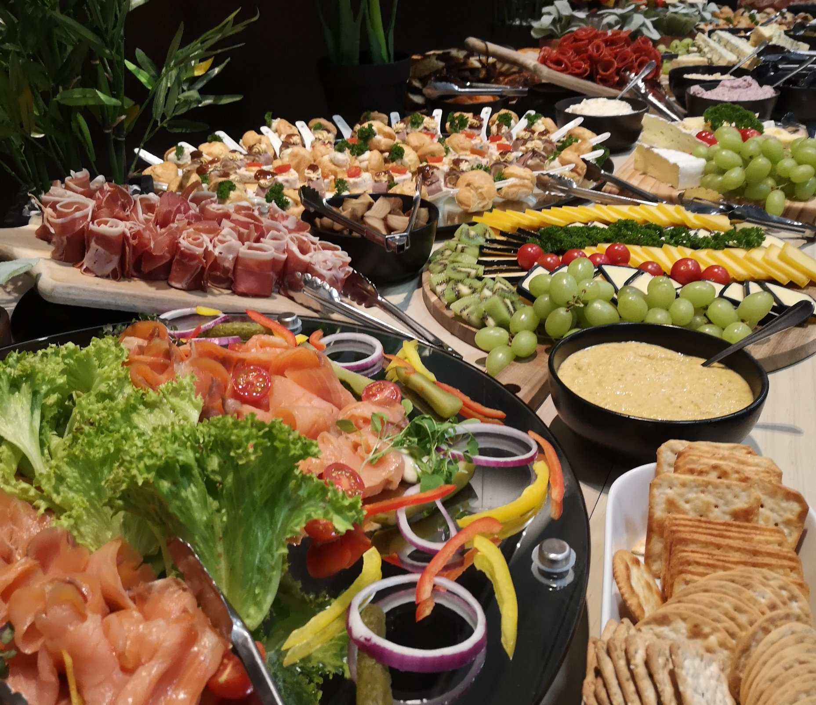
We believe that food is a celebration and should be treated as such, which is why the innovative cuisine from our Chefs is always prepared with loving care and due attention to detail.
We offer a wide array of menus to choose from, or alternatively, we can adapt our meals to suit your style, taste and budget meaning that we really do cater for everybody.
Guests with special dietary requirements are easily catered for given prior notification, through clear labelling of dishes or serving separate meals if needed.
All menu prices are inclusive of GST, and some do have minimum and maximum number restrictions – however if you really want one of those menus then please do talk to our friendly team and we will see what we can do for you!
Please be aware prices could change due to being able to get products.!
Please get in touch for fixed prices for your function.
V – Vegetarian
GF – Gluten Free
VG – Vegan
DF – Dairy Free

Slide 4
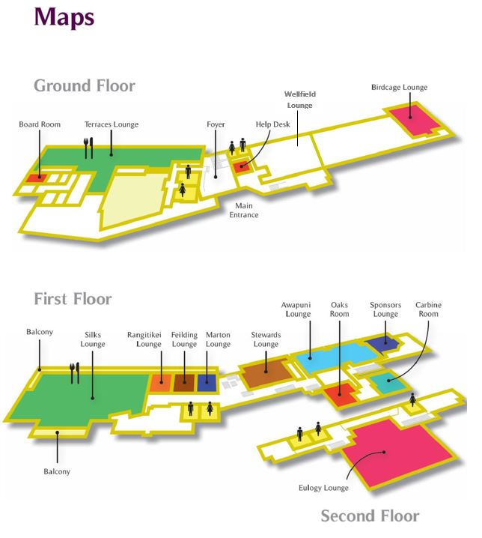

Slide 5
Capacity
venue | Theatre | Cabaret with trestles | Cabaret with rounds | Boardroom | U Shape | Cocktail | Banquet no dancefloor
Silks | 700 | 400 | 300 | 104 | 92 | 800 | 550
Feilding | 40 | 21 | 18 | 24 | 20 | 60 | 40
Marton | 40 | 21 | 18 | 24 | 20 | 60 | 40
Rangitikei | 40 | 21 | 18 | 24 | 20 | 60 | 40
Feilding-Marton | 80 | 42 | 36 | 40 | 40 | 120 | 80
Terrace | 100 | 105 | 90 | 56 | 48 | 550 | 338
Owners | 60 | 35 | 30 | 24 | 20 | 120 | 80
Stewards | 80 | 35 | 30 | 24 | 20 | 120 | 80
Awapuni | 150 | 77 | 42 | 64 | 28 | 300 | 220
Manawatu | 60 | 35 | 30 | 24 | 20 | 120 | 80
Birdcage | 80 | 63 | 42 | 32 | 28 | 150 | 100
Eulogy | 400 | 280 | 240 | 88 | 76 | 600 | 400
Oaks | 50 | 42 | 30 | 24 | 20 | 70 | 50
Carbine | 50 | 42 | 36 | 24 | 20 | 70 | 50

Slide 6
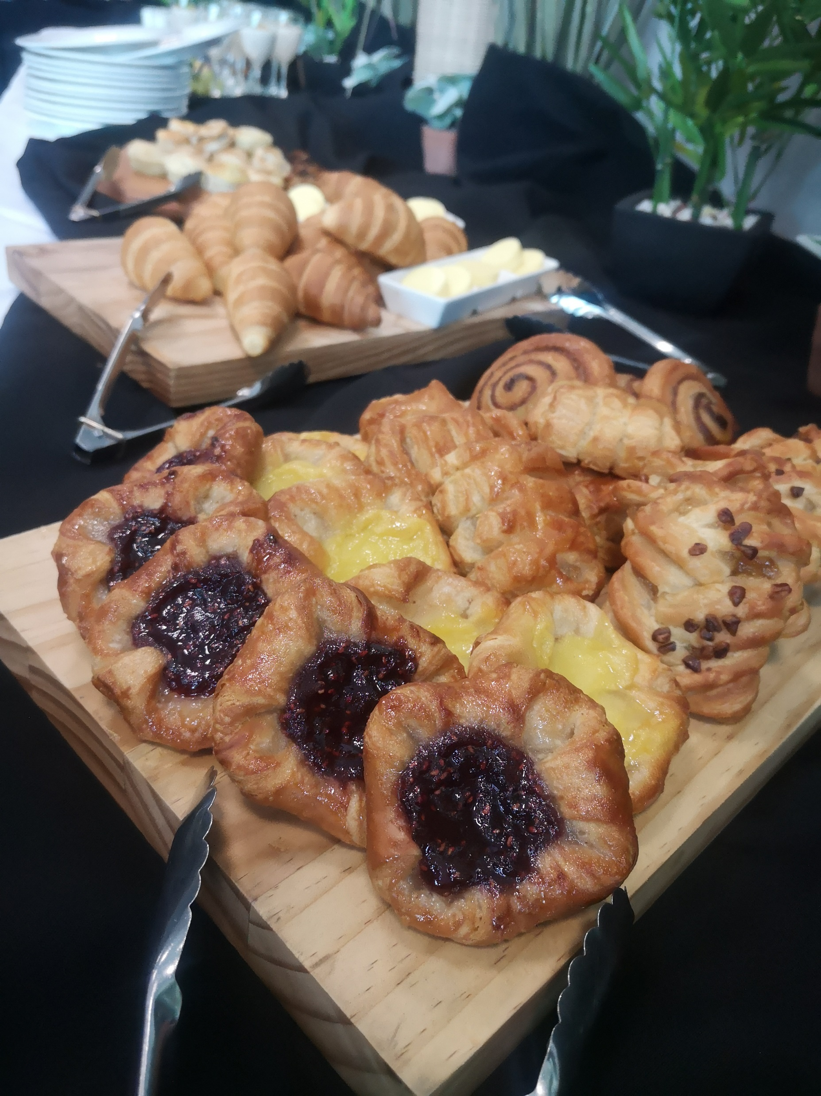
Breakfast
All breakfasts served with:
Orange juice
Selection of teas, herbal infusions & Ebony roastery coffee
Finger food Breakfast $26.00 pp
Ham and cheese croissant
Fruit Danish
Mushroom & spinach quiche
Breakfast burrito
Fruit platter
Muesli pot
Gourmet savory
Hot cooked Breakfast $35.00 pp
Cooked Breakfast: scrambled eggs, grilled bacon, fried tomatoes, sausages,
potato hash, sautéed mushrooms, toasted ciabatta with tomato relish & butter
Or
Vegetarian Cooked Breakfast: scrambled eggs, fried tomatoes, roast garlic vegetarian sausages, sautéed spinach, potato hash, mushrooms,
toasted ciabatta with tomato relish & butter
Cooked breakfast can be served as a buffet, plated or platter style

Slide 7
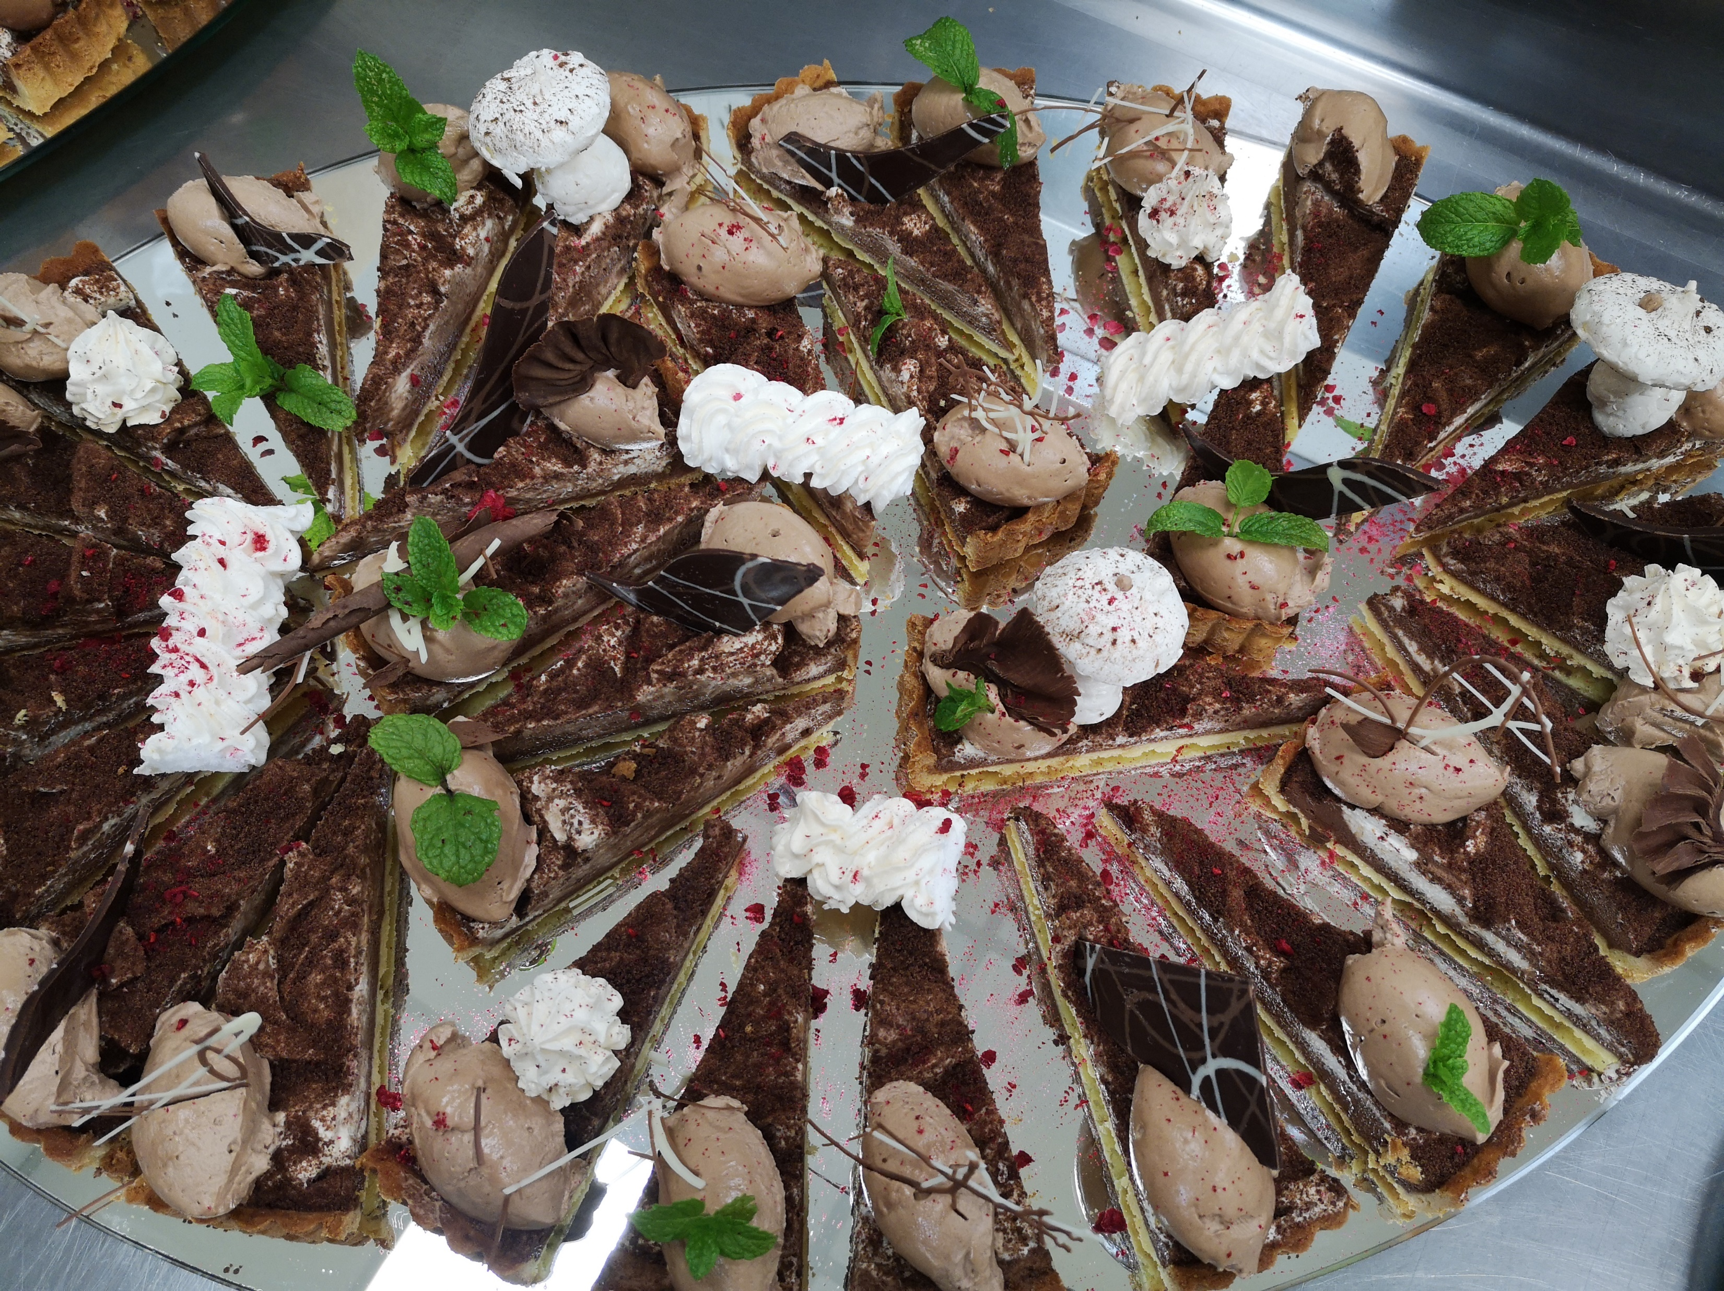
Coffee Breaks
Homemade gourmet sausage roll
Assorted finger sandwich
Savory muffin
Savory scones
Pumpkin scones
Mushroom bacon & cheese tart
Filled mini croissant
Assorted savories
Sultana scone with jam & cream
Lemon meringue pie
Sliced seasonal fresh fruit
Fruit basket
Assorted cookies
Assorted cakes & slices
Sweet muffin
Falafel wrap
Mushroom & leek blue cheese quiche
Creamy mushroom tart Vegetable frittata
Gluten free savories
Gluten Free Filled rolls
Gluten Free Caramel slice
Gluten Free Chocolate brownie
Arrival tea & coffee @ $3.50 pp
All day continuous tea & coffee @ $14.00 pp
Tea, coffee & 1 food item @ $10.50 pp
Tea, coffee & 2 food items @ $14.50 pp

Slide 8
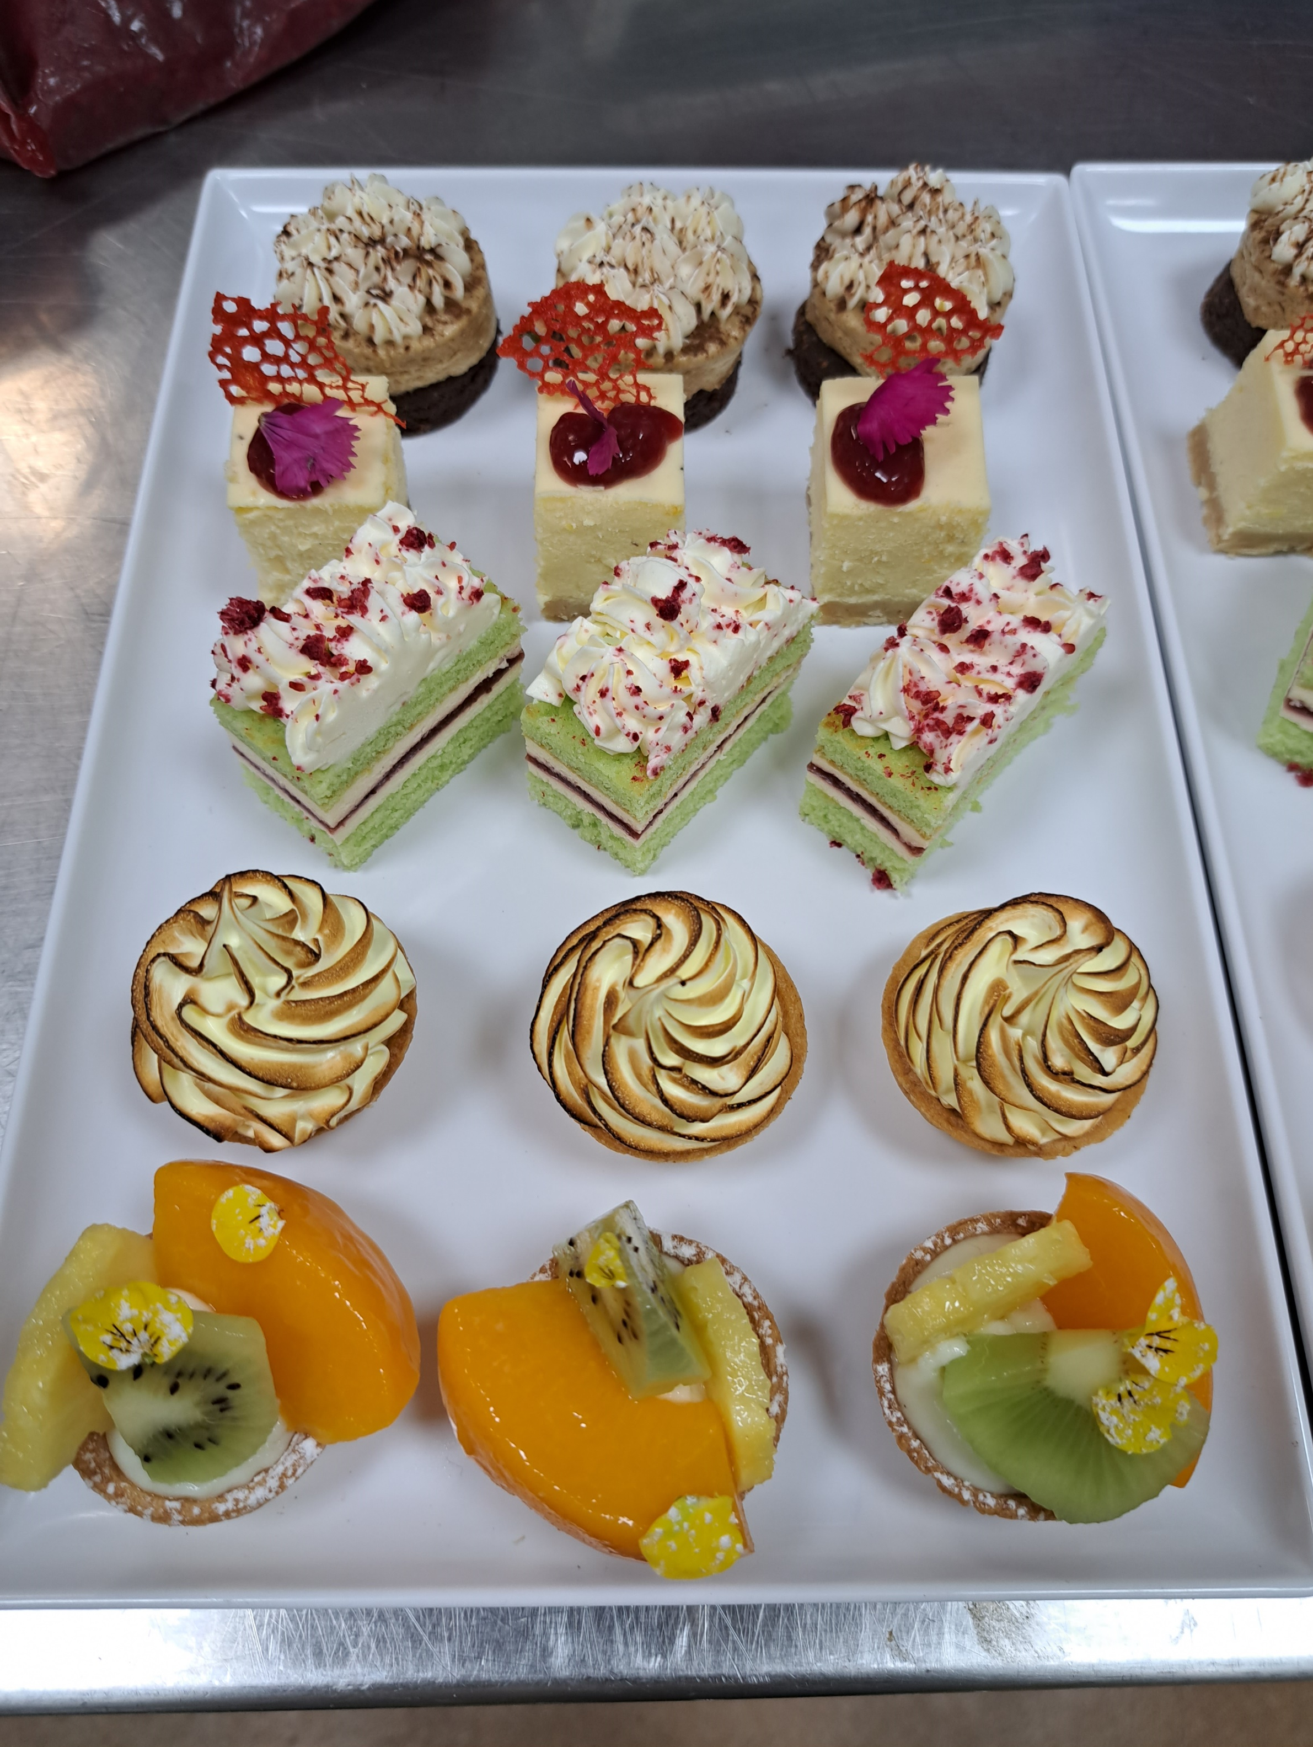
Working Lunches
Option 1 - $23.00 pp
Assorted filled rolls OR finger sandwiches
Caesar salad
Potato salad (V, GF)
Southern chicken nibbles
Assorted cakes
Option 2 - $28.00 pp
BBQ pork bao buns OR Assorted wraps
Pizza slices with assorted toppings
Roast pumpkin & raisin salad with tahini dressing (V, GF)
Seafood laksa
Sliced cakes
More options on the next page………..
Includes selection of teas, herbal infusions & Ebony roastery coffee
Minimum 15 – 100 pax
~ Dietaries catered to on request ~

Slide 9
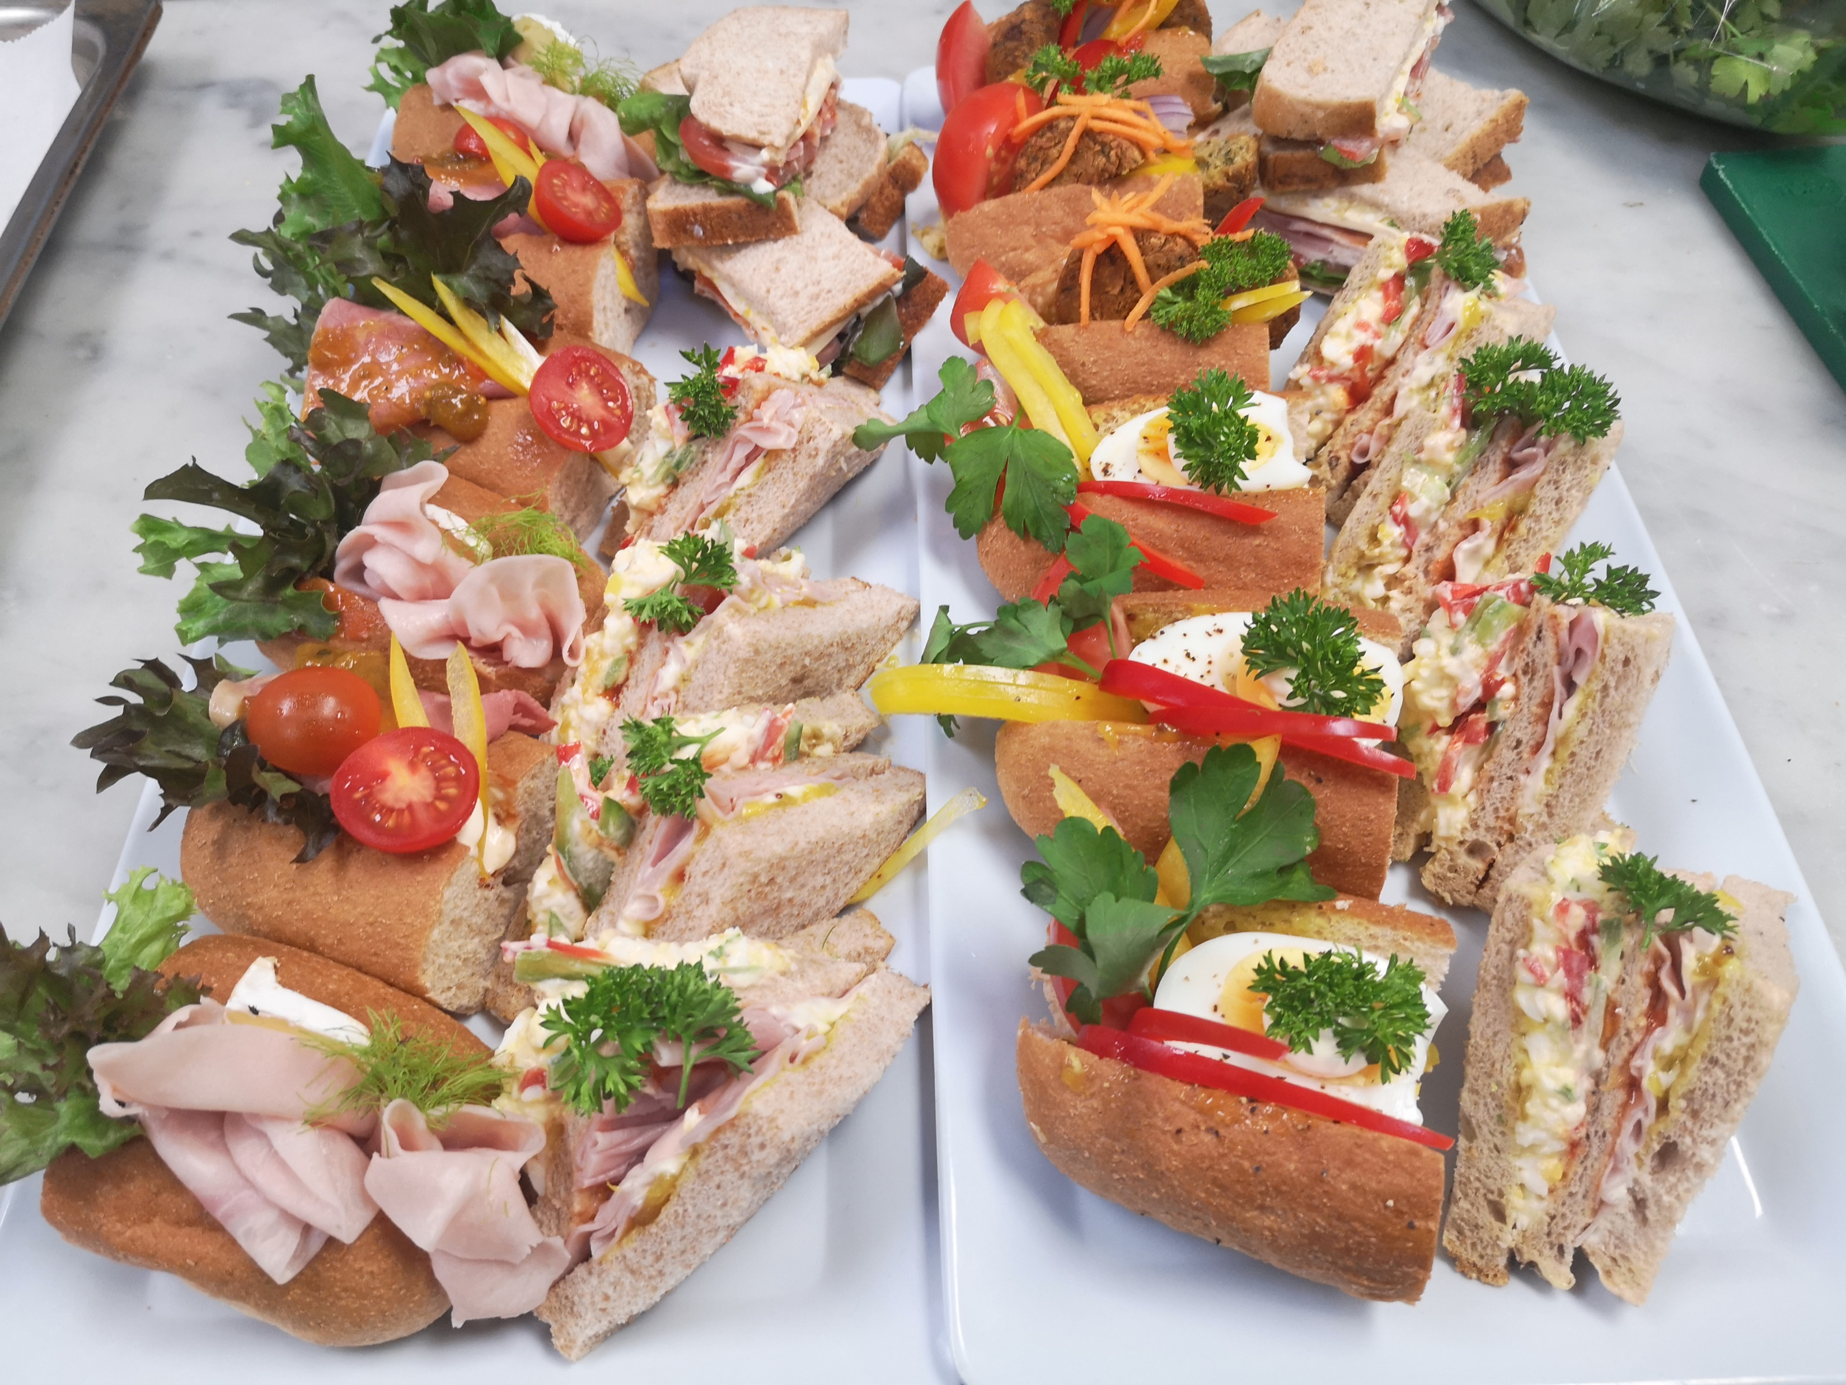
Working Lunches Continued
Option 3 - $33.00 pp
Beef kebab (GF/DF)
Assorted open sandwich
Pasta salad
Southern chicken tenders
Assorted savories
Sliced cakes
Option 4 - $37.00 pp
Assorted breads & dips
Thai beef salad (DF)
BBQ pork (GF/DF)
Chicken kebabs (GF/DF)
Roast pumpkin & raisin salad with tahini dressing (GF/DF)
Tempura battered prawns
Sliced cakes
Includes selection of teas, herbal infusions & Ebony roastery coffee
Minimum 15 – 100 pax
~ Dietaries catered to on request ~

Slide 10
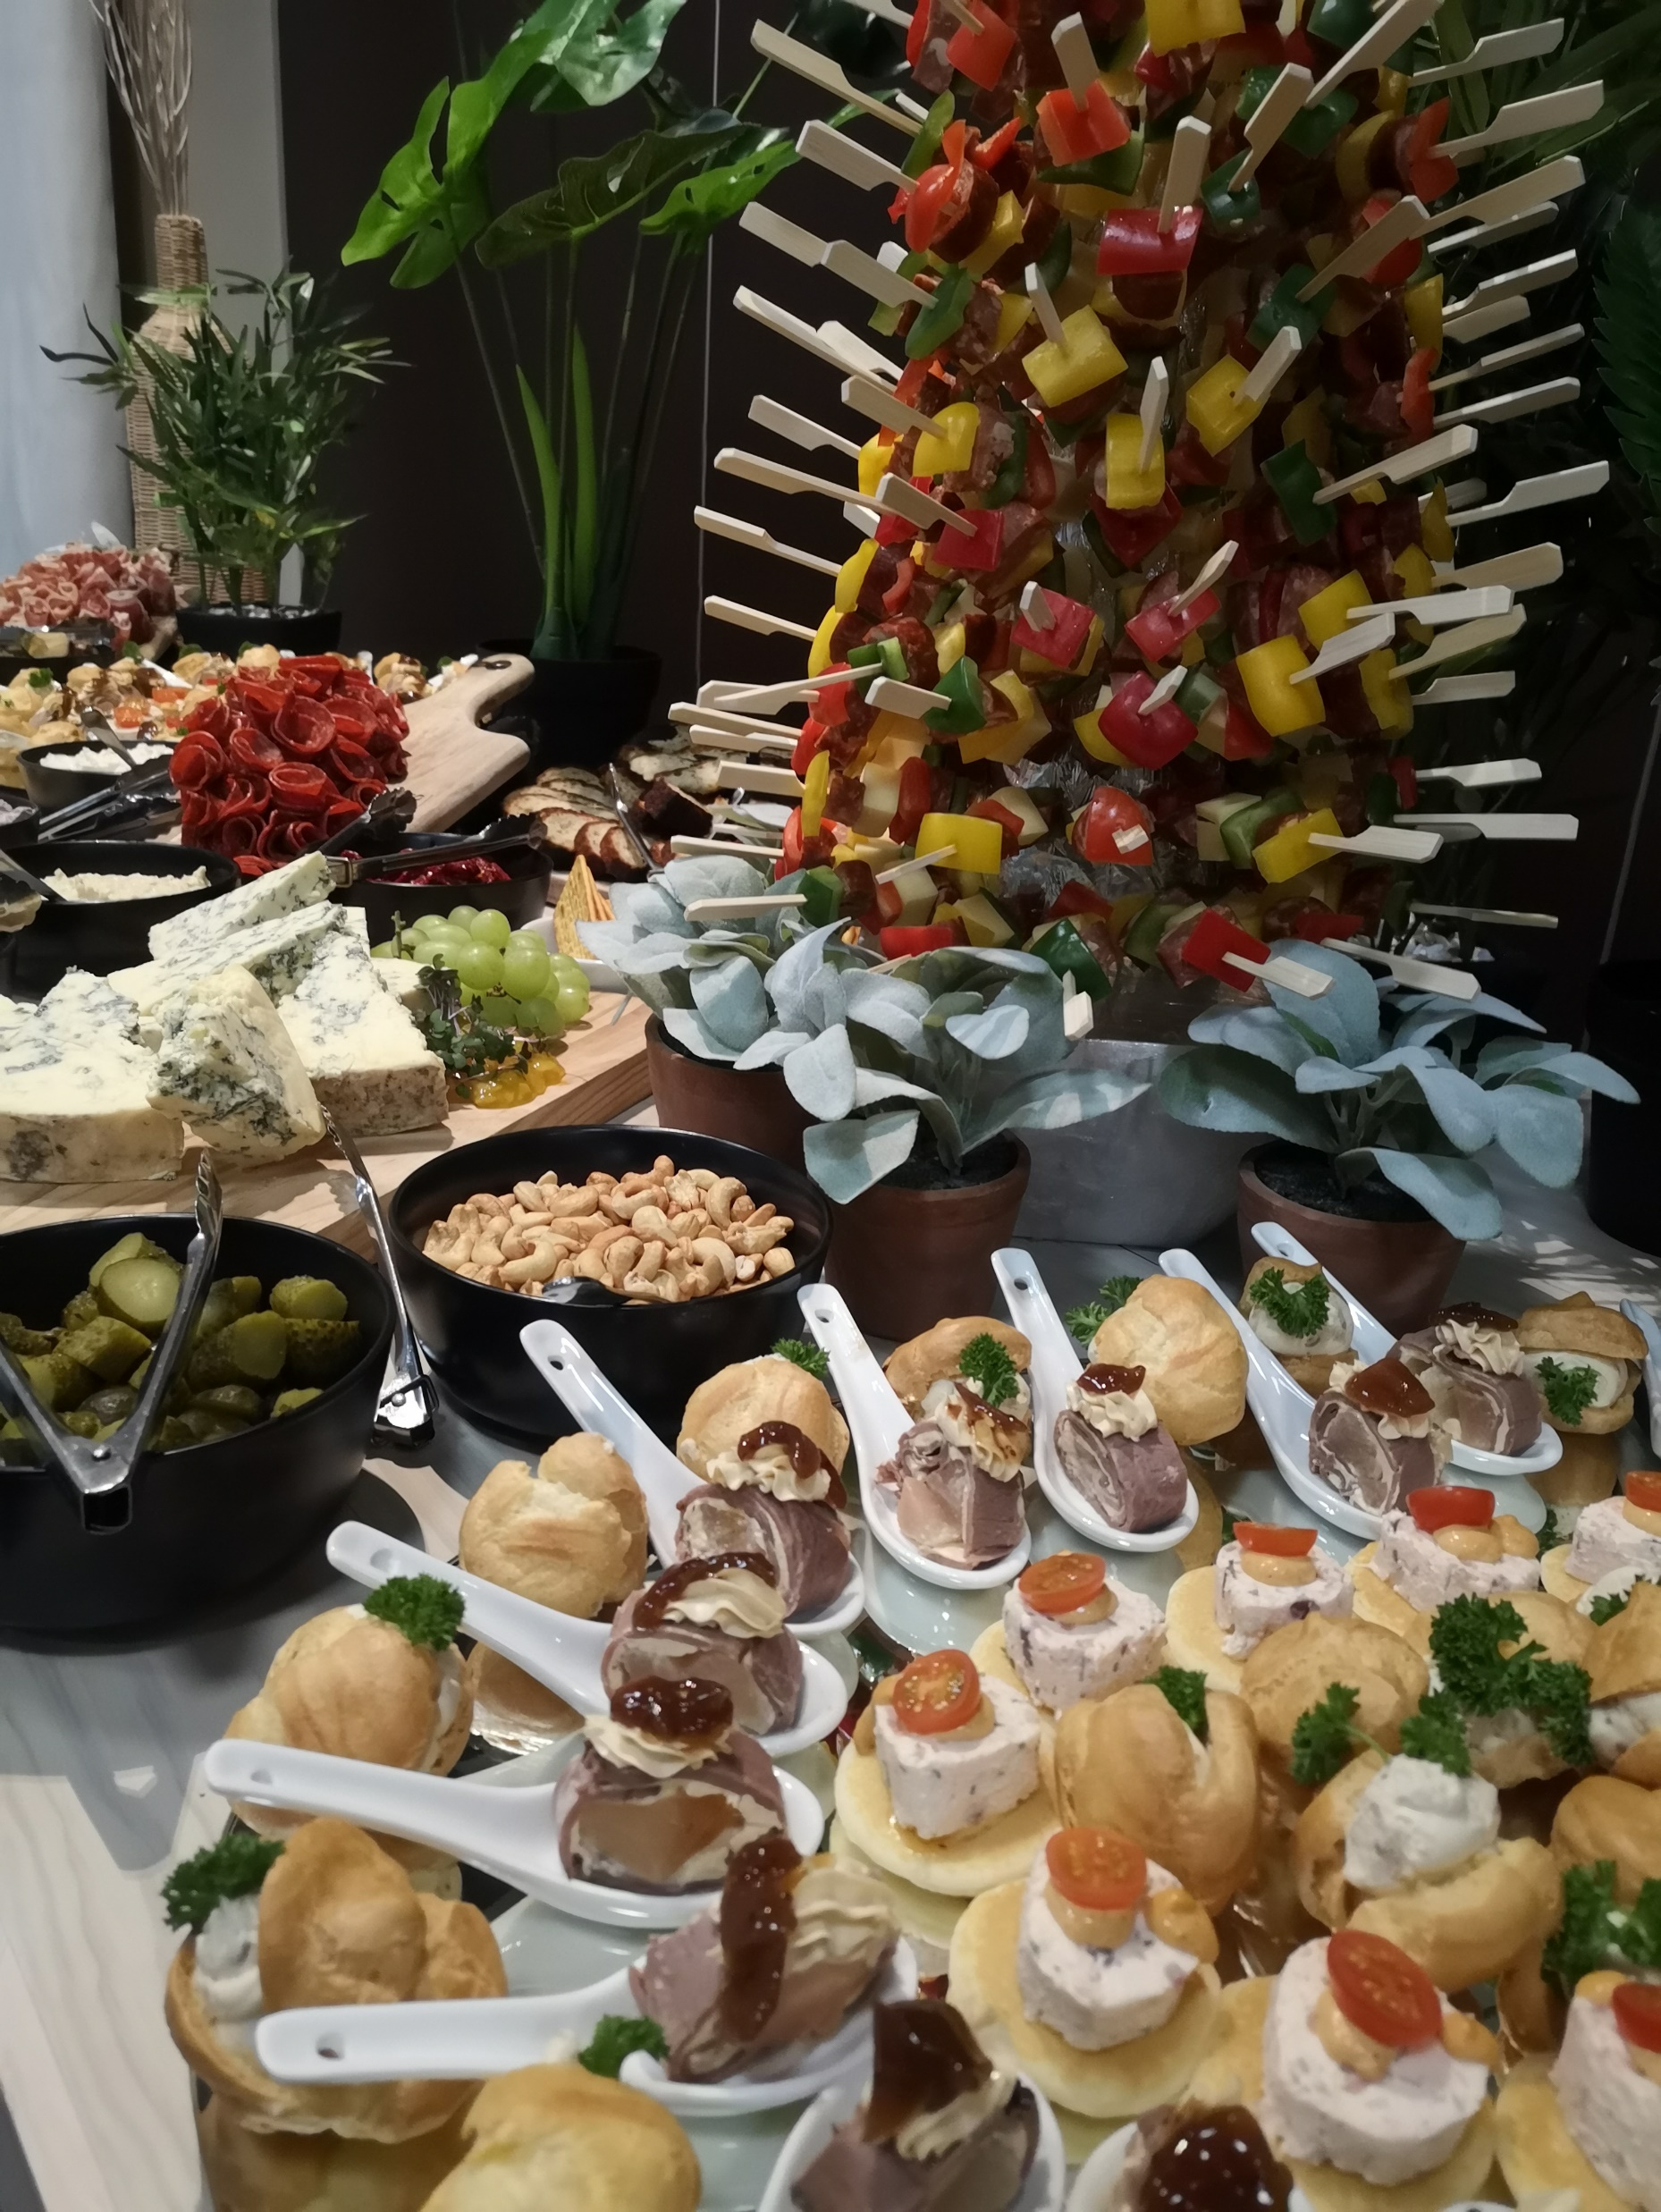
Canapes
Ocean Breeze
Italian style chili baked mussel
Lemon butter scallops with tomato onion salsa (GF)
Seafood cocktail (GF)
vodka & dill marinated salmon gravlax (GF/DF)
Smoked salmon mousse roulade (GF)
Fish tart with spicy mayo
Dill marinated fish tart with beetroot salsa.
Field Turf
Surf & turf crostini
Beef croquets with chargrilled red pepper sauce
Moroccan lamb galeite with pine nuts, chili raisin salsa
BBQ pork belly skewers (GF/DF)
Spiced pork bonbon
Potato Bread with camembert prosciutto tomato relish
Venison tartare with crispy fried anchovy & potato chips (GF/DF)
Pulled lamb with sweet potato cake (GF/DF)
Steak with pear & blue cheese salad (GF)
St Louis pork ribs (GF/DF)
Antipasto skewer (GF)
Butter chicken puff
Pigs in a blanket
Chicken arancini balls with oregano mayo
More options on the next page………..
Choice of 5 items
$28.00 pp

Slide 11
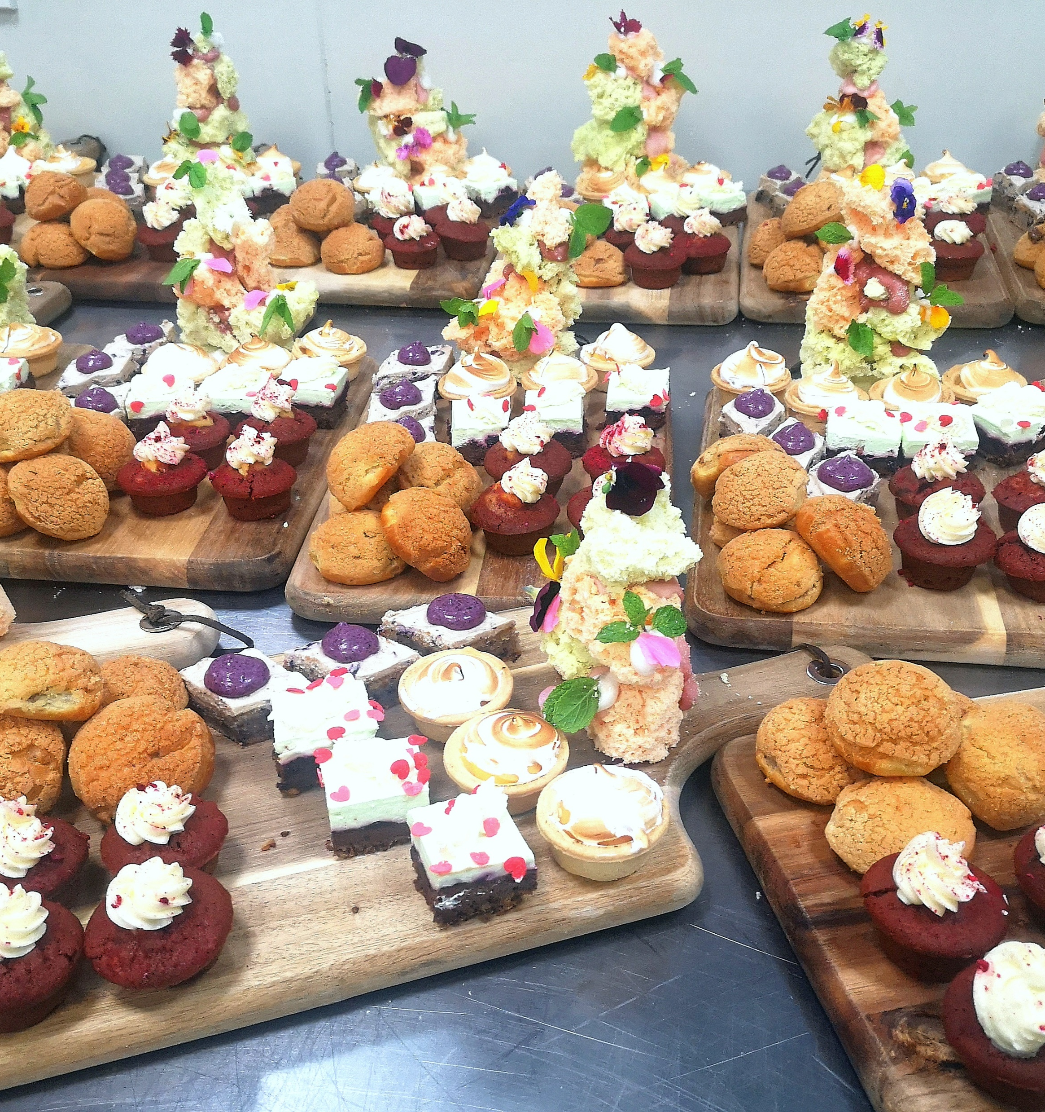
Canapes
Garden Field
Tomato mozzarella puff
Beetroot carpaccio with feta & red wine jelly (GF)
Sweet corn & cheddar fritter with harissa mayo
Gazpacho (GF)
Tapenade bruschetta with tomato red onion basil & cheese
Hummus & tomato Falafel with onion salsa (GF/DF)
Grilled halloumi skewer (GF)
Creamy herb pumpkin tart
Deconstructed spicy pumpkin wonton with feta & current jelly
Sweet Land
Creamy lemon meringue
Blueberry delight
Black forest cake
Crunchy chocolate mousse
Coffee cream bun
Cheesecake
Special extras - $6.50 pp per item
Oyster with red wine dressing (GF/DF)
Selection of sushi
Prawns & salmon ceviche with herb cream fraiche blinis
Gourmet pizza
Marinated duck breast with lentil cake & orange jelly (GF/DF)

Slide 12
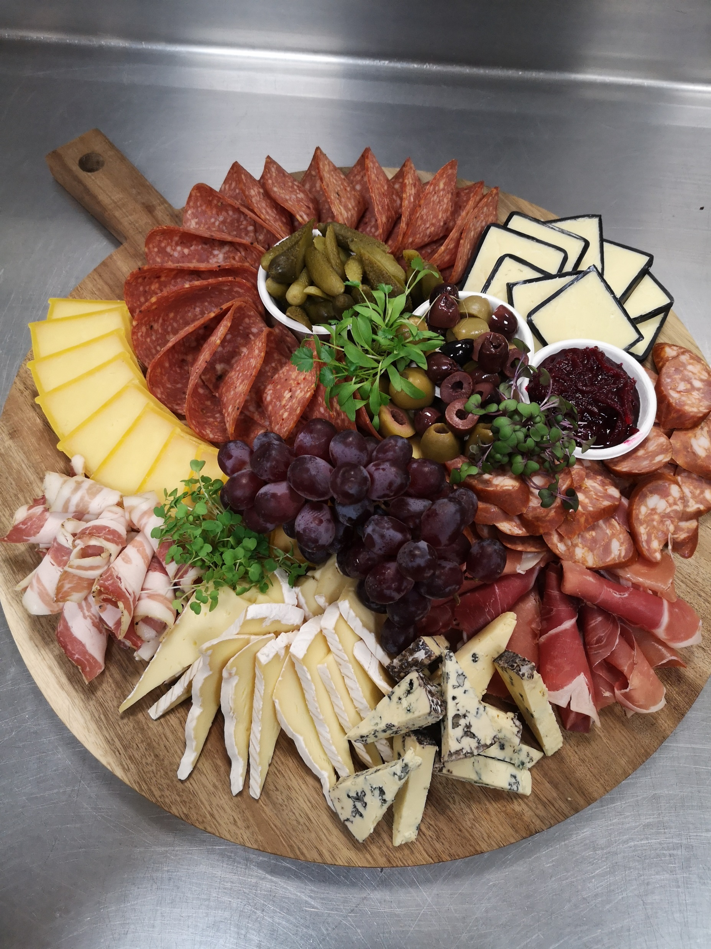
Creative Cheeseboards
Prince cheeseboard - $68.00
3 types of NZ cheeses’
Selection of chutneys & pickles
Dried fruits & nuts
A range of crackers & breads
Queen cheeseboard - $78.00
5 types of NZ cheeses’
Selection of chutneys & pickles
Dried fruits & nuts
A range of crackers & breads
King cheeseboard - $95.00
7 types of NZ cheeses’
Selection of chutneys & pickles
Dried fruits & nuts
A range of crackers & breads
Lavosh/Grissini
Cheeseboards designed for 20 pax

Slide 13
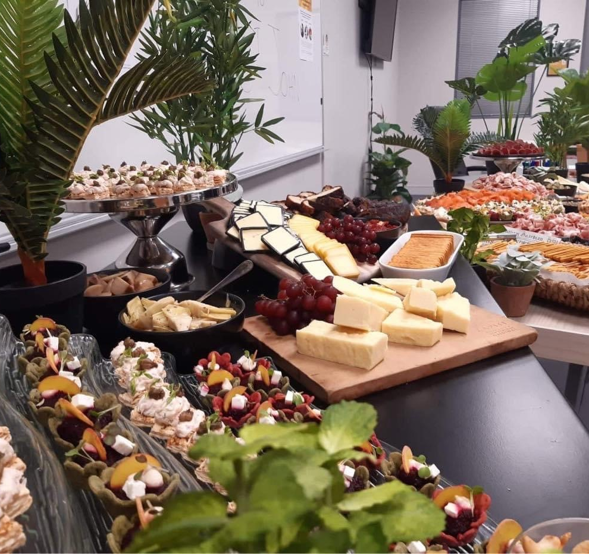
Creative Grazing Tables
Prince grazing table – starting from $320.00 for 20pax
3 types of NZ cheeses’
3 varieties of cured meats
Selection of chutneys & pickles
Dried fruits & nuts
A range of crackers & breads
Queen grazing table – starting from $460.00 for 30 pax
4 types of NZ cheeses’
3 varieties of cured meats
Smoked salmon
Selection of chutneys & pickles
Dried fruits & nuts
A range of crackers & breads
Chef choice of 4 canapes
More options on the next page………..

Slide 14
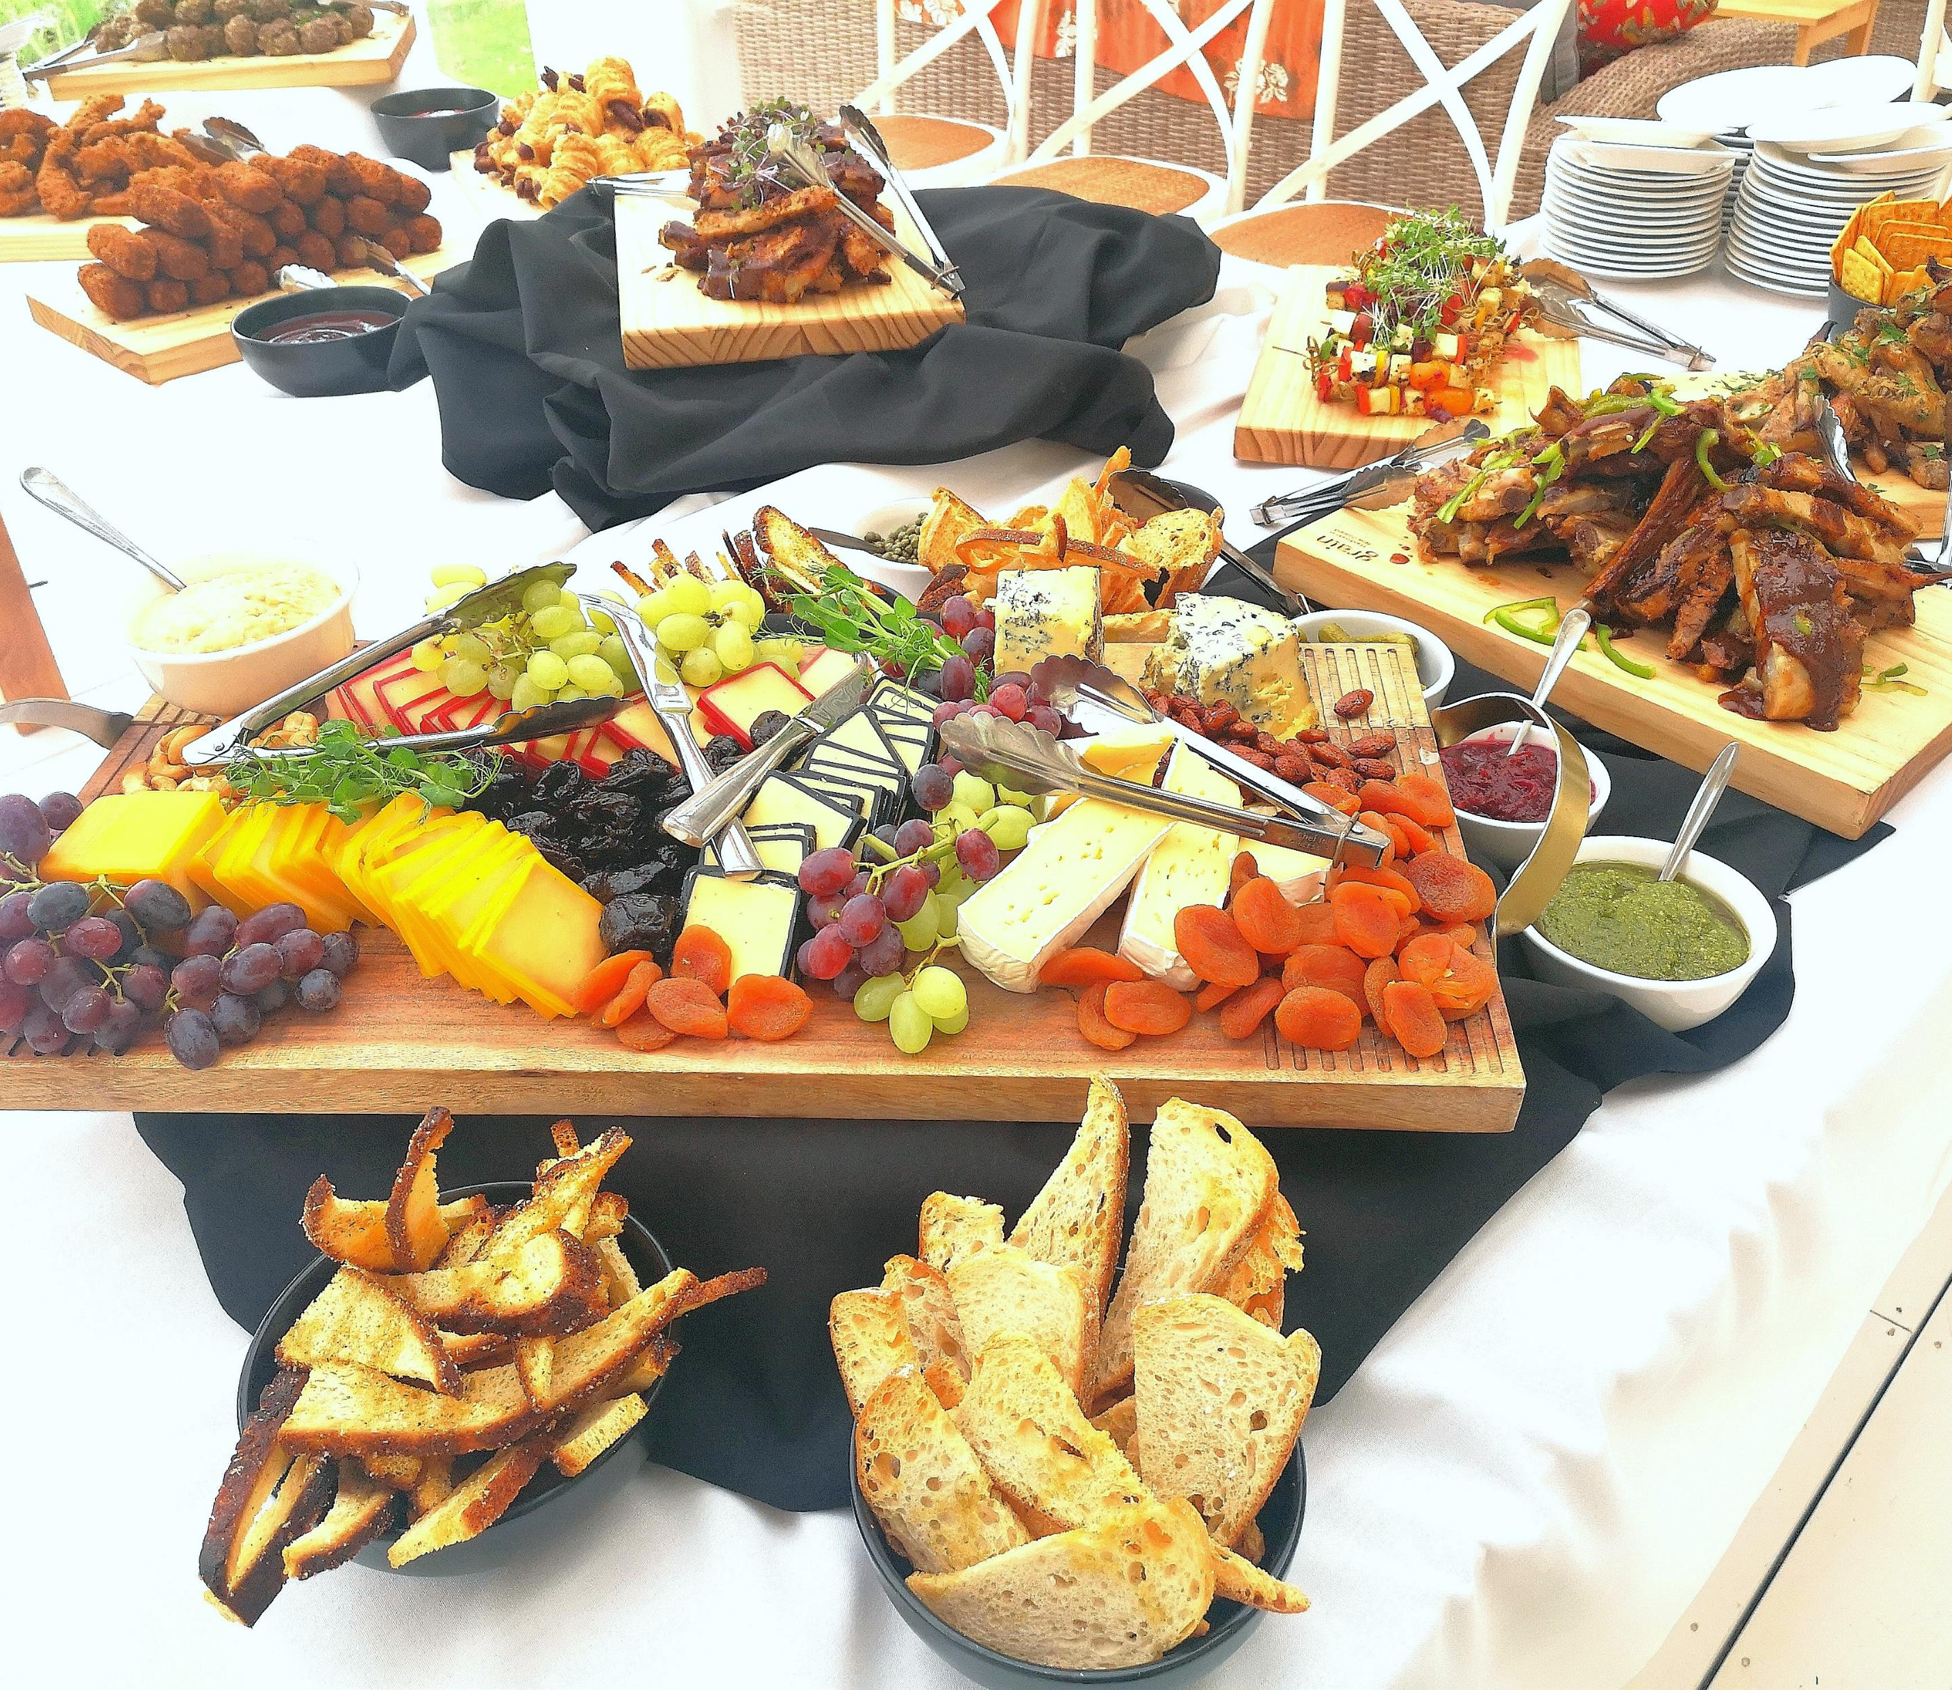
Creative Grazing Tables
King grazing table – starting from $810.00 for 50 pax
5 types of NZ cheeses’
4 varieties of cured meats
Smoked salmon
Selection of chutneys & pickles
Dried fruits & nuts
A range of crackers & breads
Chef choice of 5 hot canapes
Super king grazing table – starting from $985.00 for 60 pax
7 types of NZ cheeses’
6 varieties of cured meats
Smoked salmon
Selection of chutneys & pickles
Dried fruits & nuts
A range of crackers & breads
Chef choice of 6 hot, cold & sweet canapes

Slide 15
Gourmet Platters All Homemade on site
Meat lovers - $80.00
BBQ Pork, Pork Ribs, Sicilian meat loaf, venison sausages, Fried Chicken nibbles.
Seafood Odyssey - $80.00
NZ ocean freshest seafood with accompaniments
Southern - $80.00
Fried chicken, pulled beef croquettes, grilled halloumi with pine nut sauce, marinated beef skewer, mac n cheese ball, Potato bread with salsa butter.
Butchery Grill - $80.00
BBQ chicken nibbles, lamb kofta, chorizo sausage, marinated beef cheek, roast pork belly
Plant-based & vegetarian - $65.00
Mushroom hemp meatballs, chickpea taco, teriyaki tempeh, pumpkin, beans & broccoli crêpe, marinated & battered fried tofu
Bakehouse selection - $65.00
steak pies, chicken pies, house made sausage rolls, ham & egg quiche
Sausage platter - $70.00
Selection of Artisan sausages
More options on the next page………..
Platters designed for 10 pax
Served with a selection of dipping sauces

Slide 16
Gourmet Platters continued
Seasonal Fruit Platter - $70.00
A mixture of seasonal fresh fruit served with honey, lemon, yoghurt dressing Dried fruits - apricot, prunes & dates
Around Asia - $80.00
Pork wontons, prawn dumplings, prawn twists, vegetable spring rolls, Thai fishcakes, Thai beef salad, potato balls
Ultimate deserts - $80.00
A mixture of confectionary & homemade deserts
Dipping sauces – complimentary
Chimichurri, cranberry, spicy mayo, plum sauce, apple sauce, hummus, BBQ sauce, sweet chilli, tomato, pesto, roast sesame dressing
Platters designed for 10 pax
Dips will be provided accordingly - if you would like extras you can request at no extra cost

Slide 17
BBQ Menu
assorted rustic breads with butter & condiments
Hot station
Marinated scotch fillet minute steals (125g) (GF/DF)
Grilled beef kebab (GF/DF)
Beef rump seasoned with garlic & parmesan crust
Lemon Thyme marinated chicken drums (GF/DF)
Lemon grass chili & coriander chicken (GF/DF)
Huli Huli Hawaiian chicken
Sausages & pineapple skewers (GF)
Sosaties chicken (South African kababs)
Bacon wrapped BBQ fatty (pork belly)
Korean spice BBQ pork belly (GF/DF)
Grilled Spanish chorizo (GF/DF)
Scallops & prawn skewers (GF/DF)
Grilled vegetarian skewer (VE/V/GF/DF)
Honey mustard marinated halloumi skewer (VE,GF)
Teriyaki & sesame tempeh skewers with peanut dressing (VE/V/DF/GF)
Cajun seasoned mushroom& pineapple skewers (VE/V/DF/GF)
Salads on next page….

Slide 18
BBQ Menu continued
Salad station
Roasted potato & egg salad with chipolata mayo (GF)
Italian pasta salad with parmesan
Quinoa salad (GF)
Mexican Caesar salad
Calypso salad (noodles, mango, cashew, coriander)
Carbonara orzo rezone
Roast cauliflower with hummus & Greek yoghurt (GF)
Tuna broccoli salad (GF/DF)
Garden Salad (VE/V/GF/DF)
Additional
Deserts can be added on by request – or client can provide birthday/wedding cake to be cut up
Includes selection of teas, herbal infusions & Ebony roastery coffee,
A choice of 3 hots & 3 salads $65.00 pp
A choice of 4 hots & 4 salads $75.00 pp

Slide 19
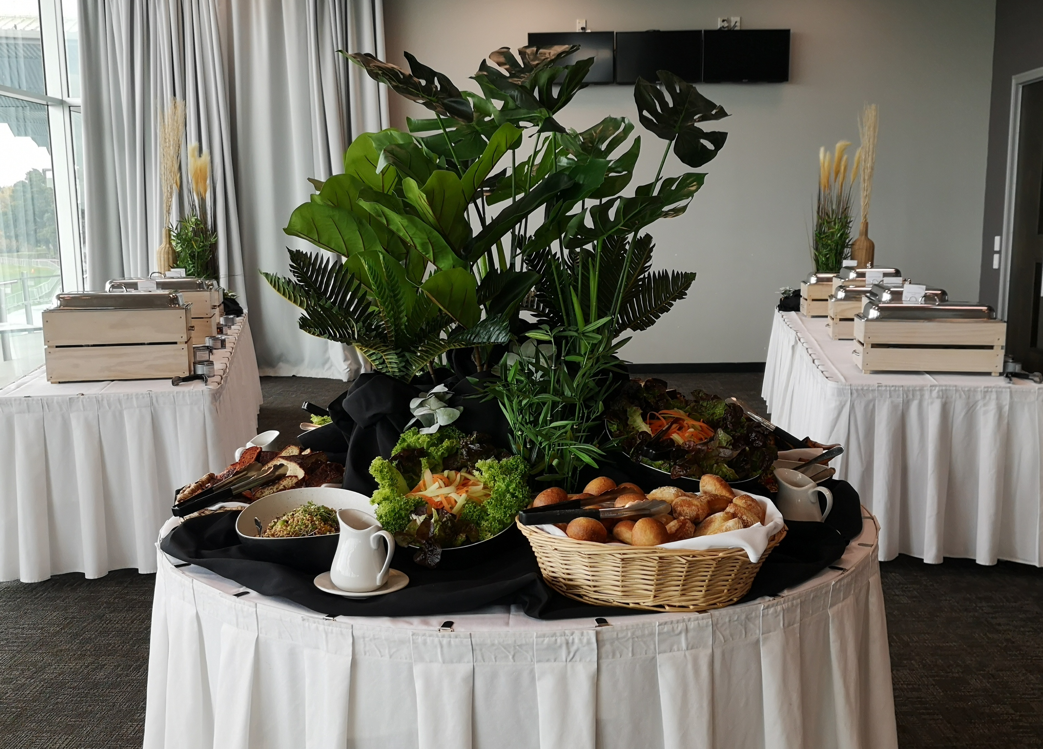
Buffet 1
Bread
Assorted rustic breads with butter
Cold Station
Green salad with herb garlic dressing (GF/DF)
Potato salad (GF)
Hot Station
Herb roast chicken (GF)
Fried rice (GF/DF/V/VE)
Garden fresh vegetables (GF/DF)
Dessert
Assorted sweet treats
Carvery Station - $9.00 pp per meat
Roast ham
Roast beef
Roast pork
Includes condiments:
Mustard, apple sauce, horseradish cream, Yorkshire pudding
Includes selection of teas, herbal infusions & Ebony roastery coffee
$55.00 pp

Slide 20
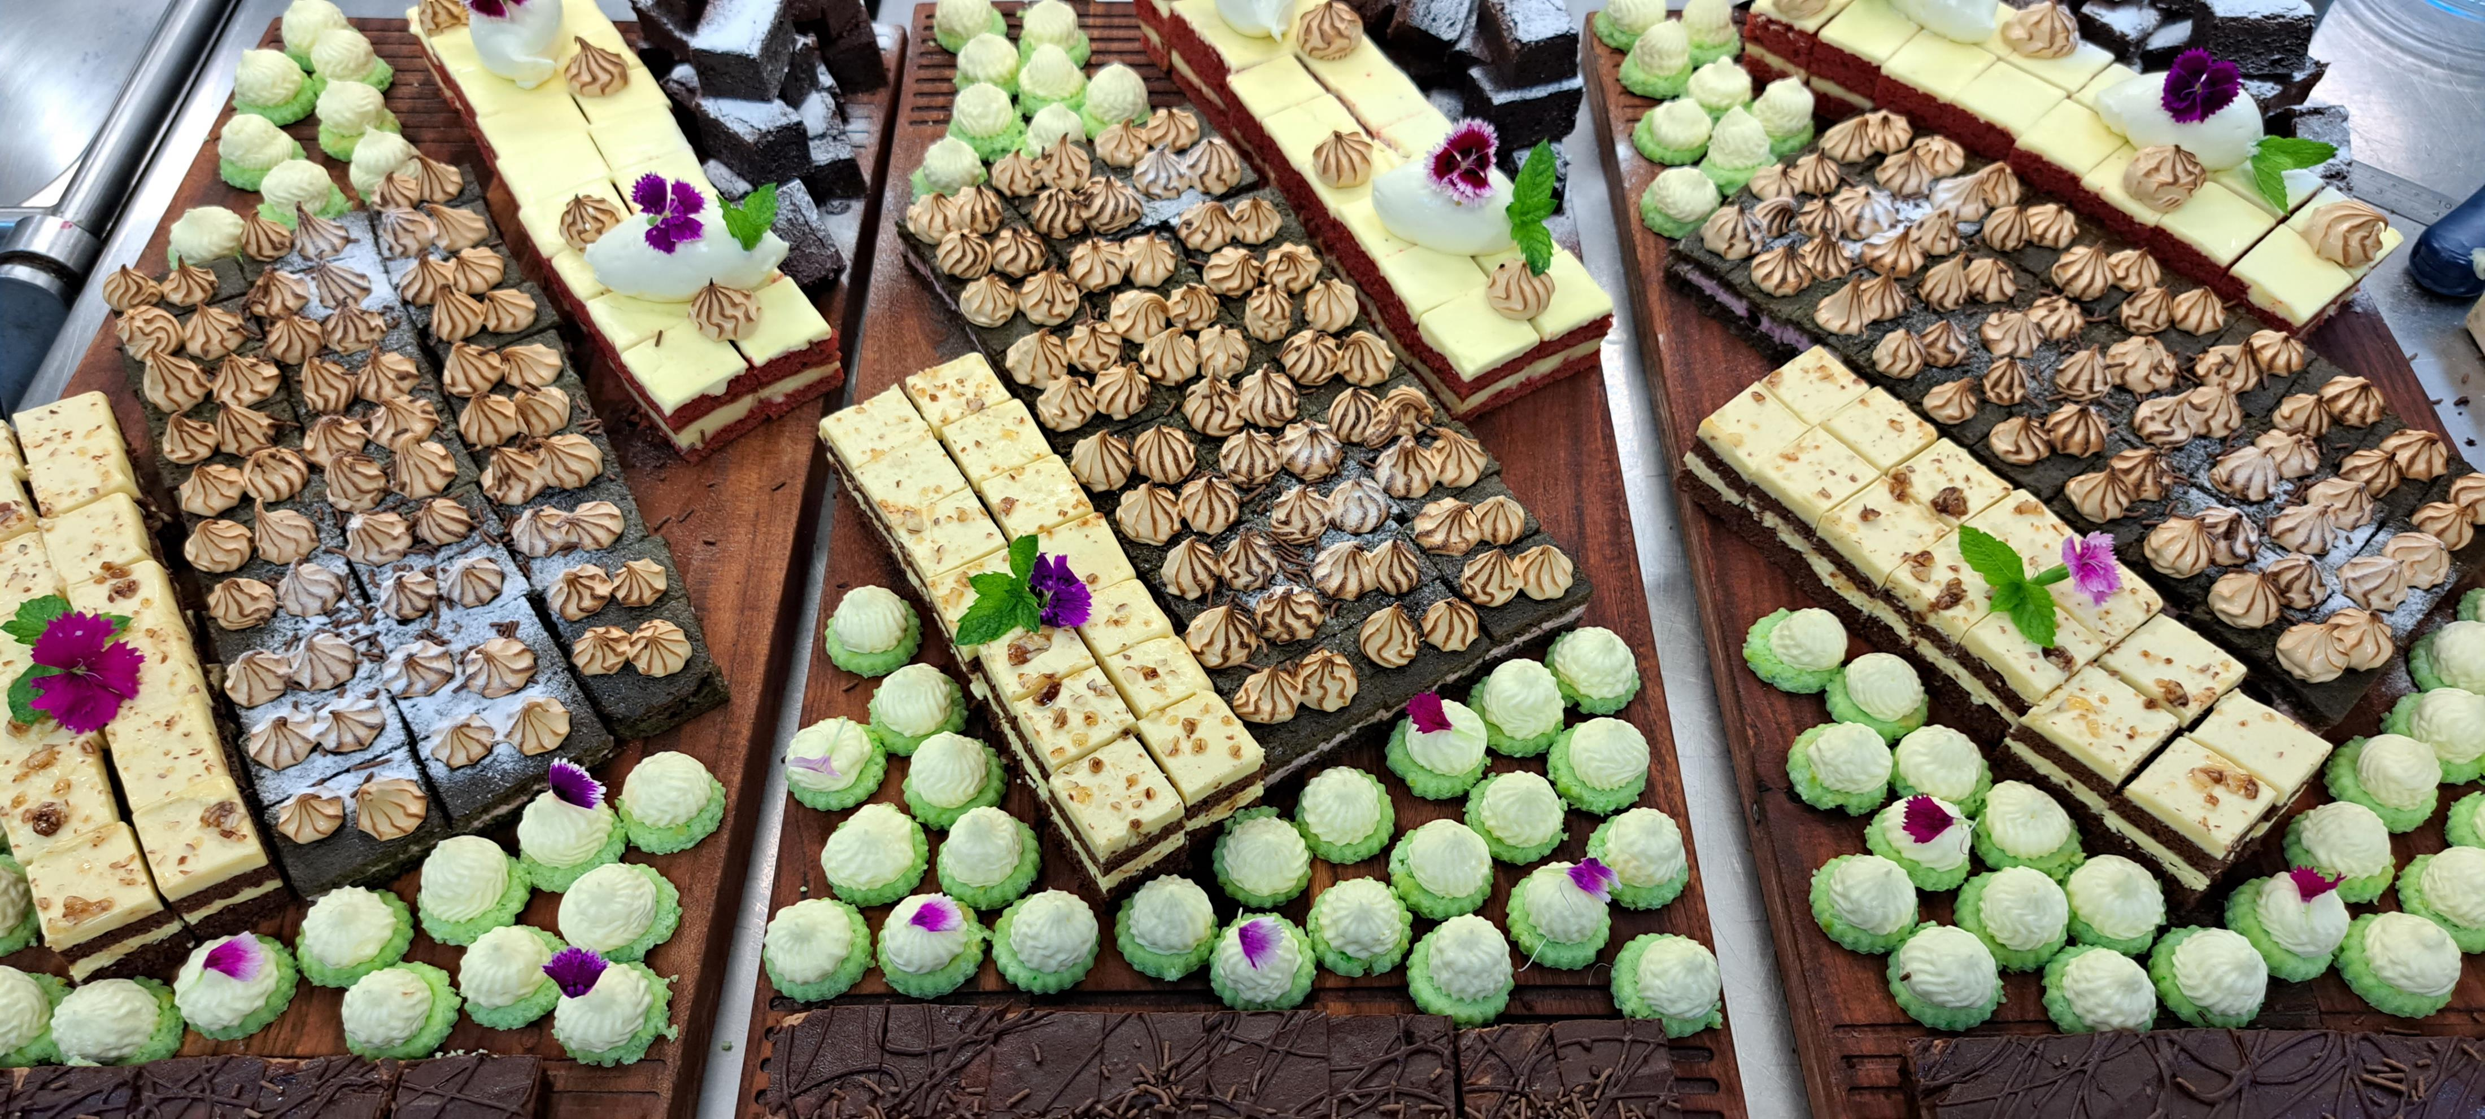
Buffet 2
Bread
Assorted rustic breads with butter
Cold Station
Green salad with herb garlic dressing (GF/DF/V/VE)
Mix Beans and cheese salad (GF)
Hot Station
Chicken cacciatore (GF/DF)
Slow roast beef with sun dried tomato tapenade (GF/DF)
Herb roast potato (GF/DF/V/VE)
Greek Lemon Orzo Pasta
Broccoli & cauliflower bake
Dessert
Creative Assorted Dessert Buffet with
Fresh seasonal fruit (V, GF, DF)
Carvery Station - $9.00 pp per meat
Roast ham
Roast beef
Roast pork
Includes condiments:
Mustard, apple sauce, horseradish cream, Yorkshire pudding
infusions &
Includes selection of teas, herbal Ebony roastery coffee
$65.00 pp

Slide 21
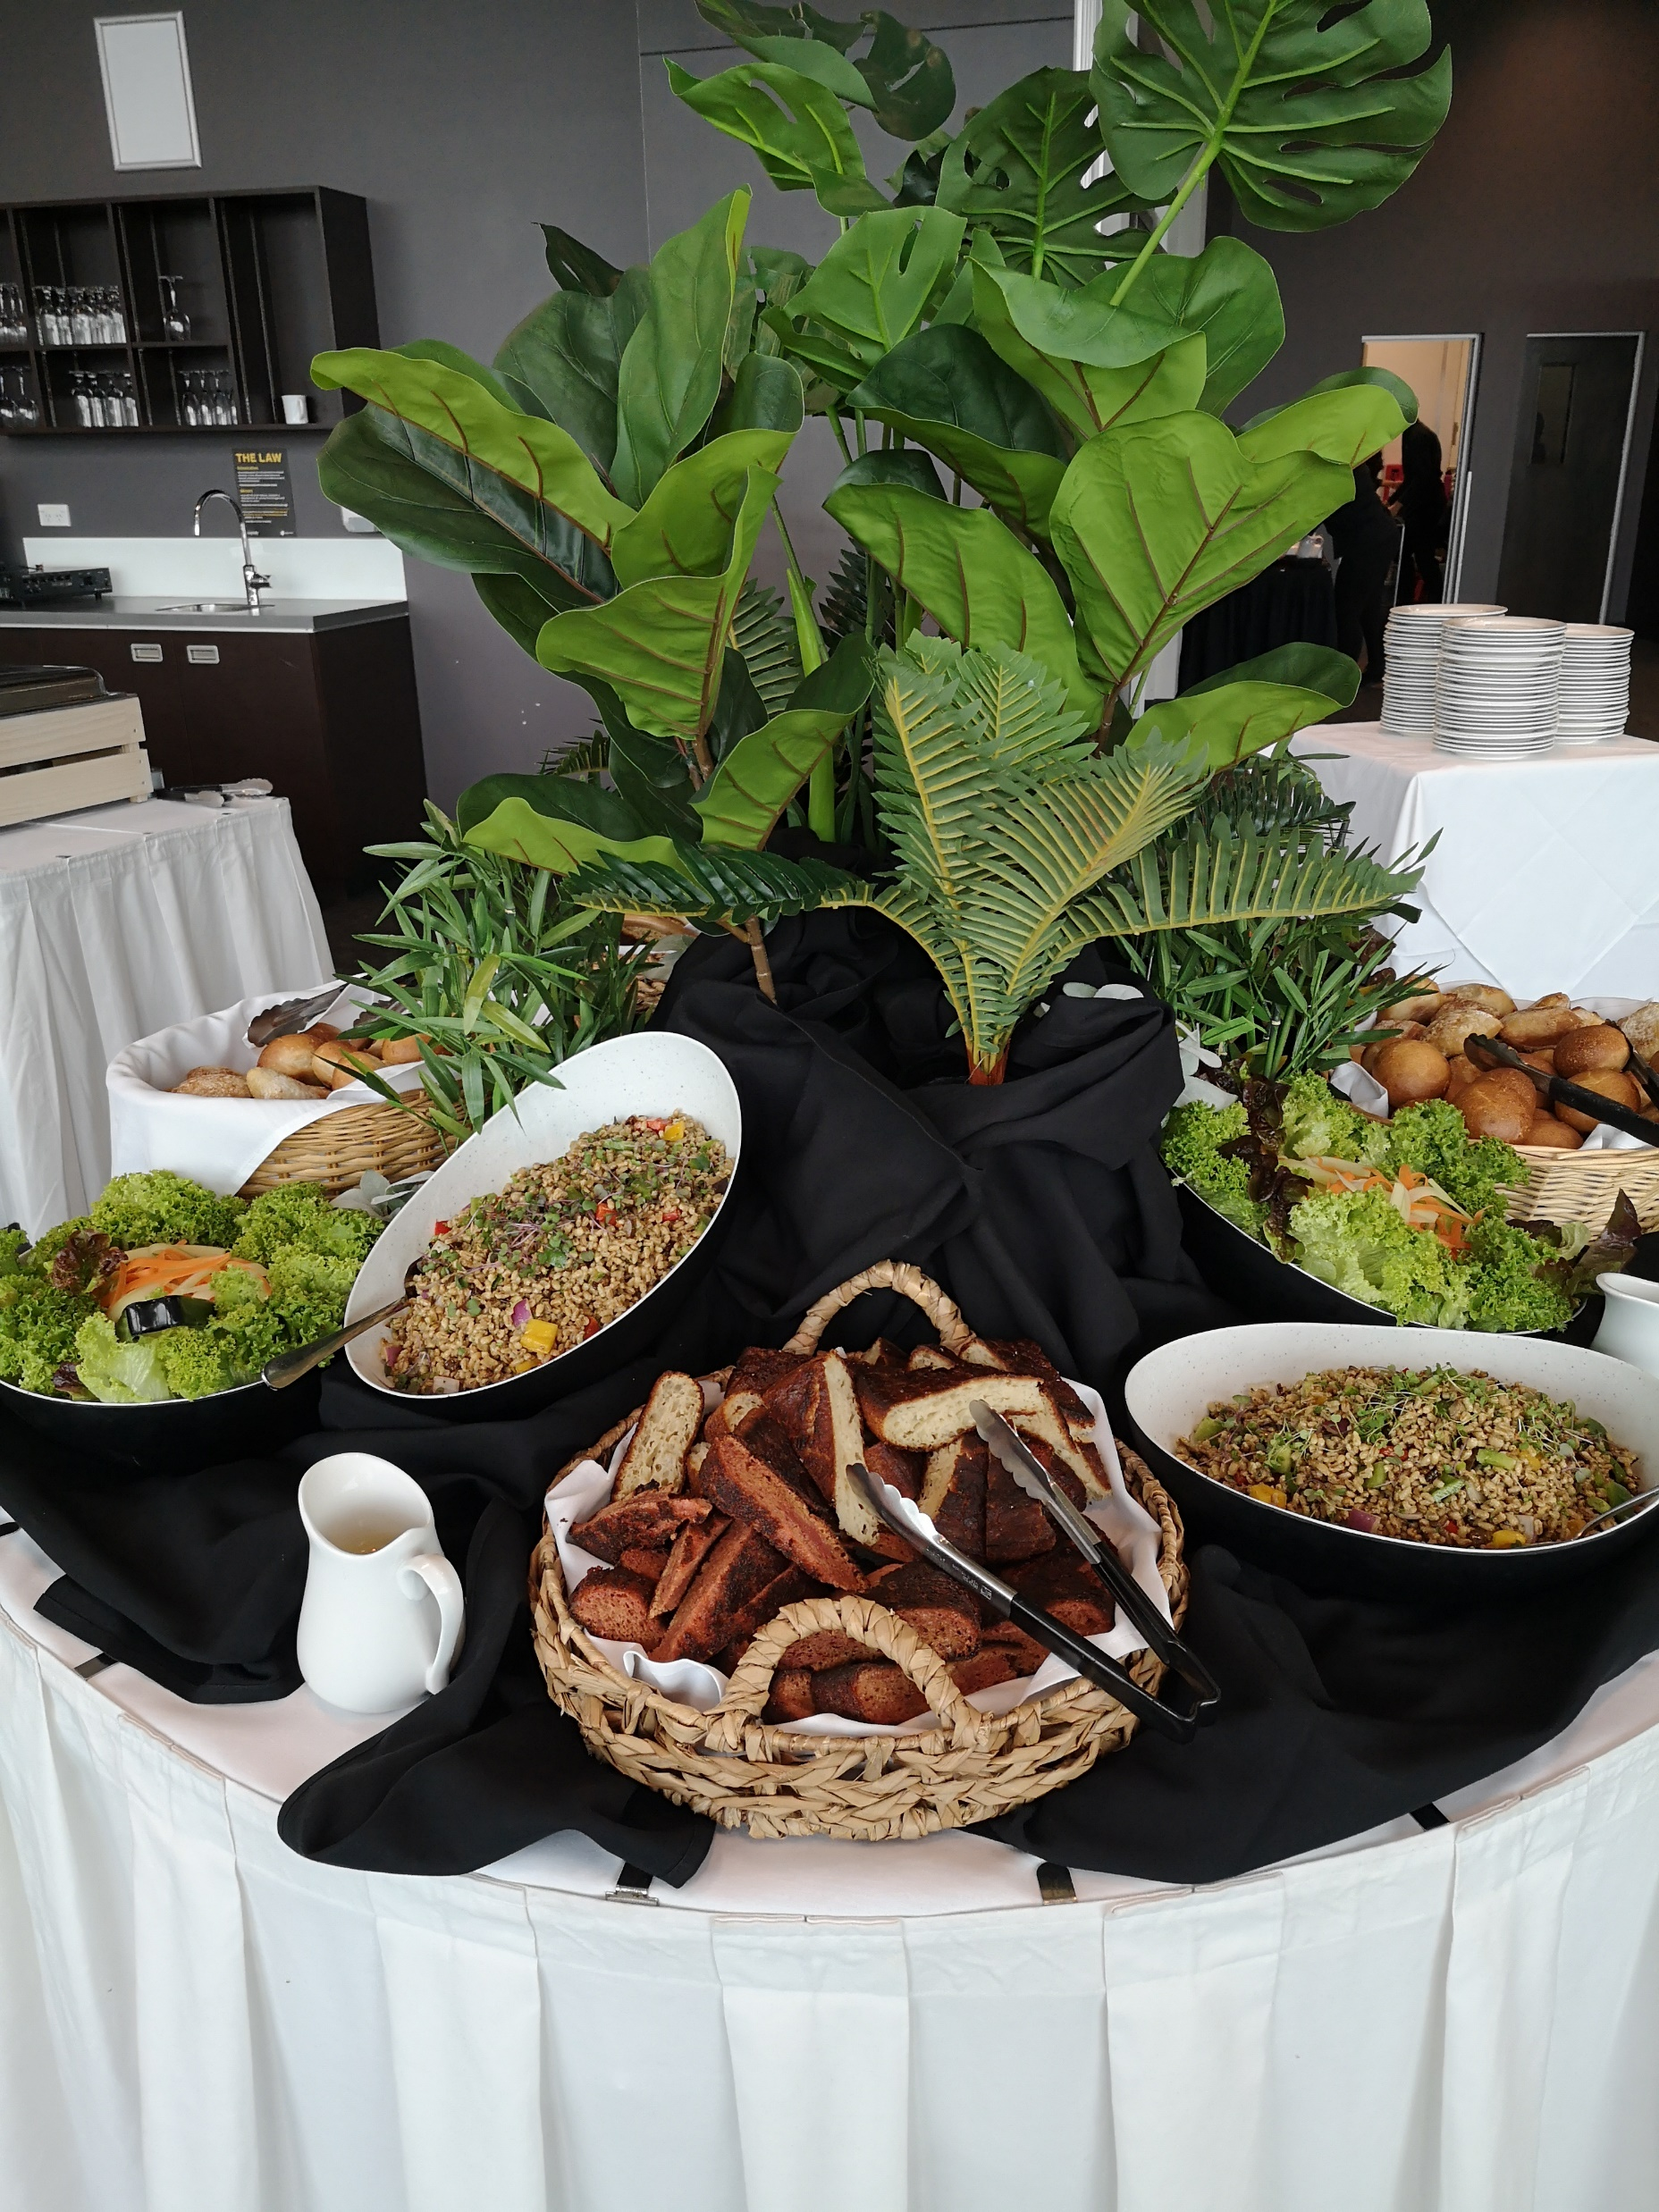
Buffet 3
Bread
Assorted rustic breads with butter
Cold Station
Green salad with herb & ginger dressing (GF/DF/V/VE)
Egg & vegetable salad (GF)
Roasted beetroot halloumi salad (GF)
Hot Station
Herb roast chicken with Creamy mushroom & leeks (GF)
Fennel & Sage Marinated pork with Apple chutney (GF/DF)
Herb, Garlic & Chili Spaghetti (aglio e olio)
Rustic potato (GF/DF)
Garden fresh vegetable (GF/DF)
Dessert
Creative Assorted Dessert Buffet with
Fresh seasonal fruit (V, GF, DF)
Carvery Station - $9.00 pp per meat
Roast ham
Roast beef
Roast pork
Includes condiments:
Mustard, apple sauce, horseradish cream, Yorkshire pudding
Includes selection of teas, herbal infusions & Ebony roastery coffee
$75.00 pp

Slide 22
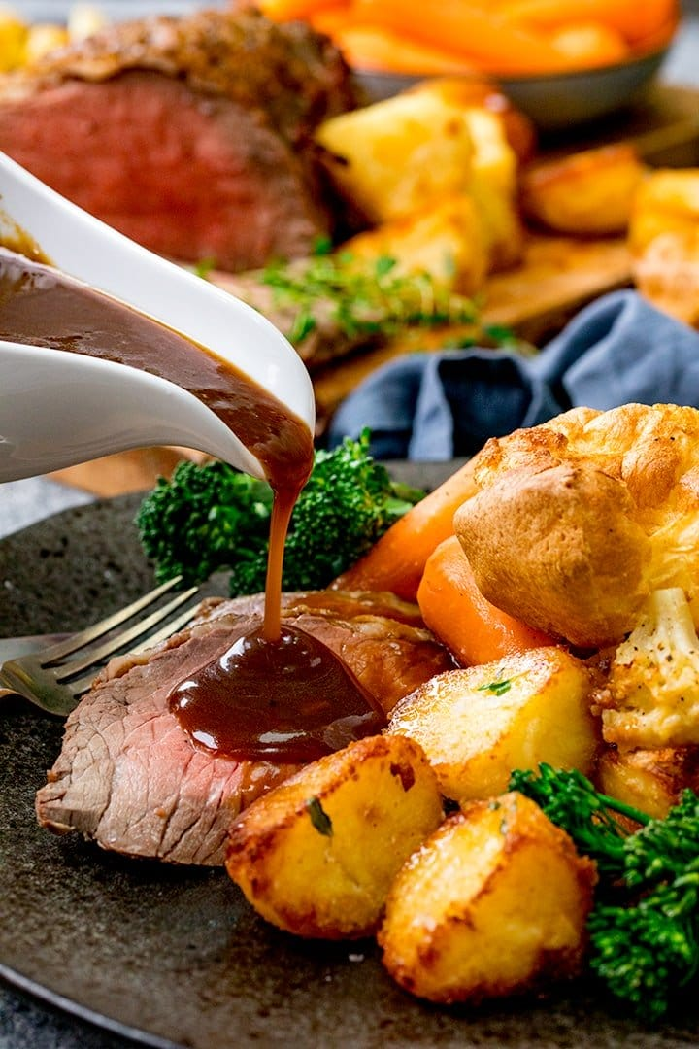
Buffet 4
Bread
Assorted rustic breads with butter
Cold Station
Green salad with balsamic dressing (GF/DF/V/VE)
Greek salad (GF)
Corn and pea salad (GF)
Hot Station
Chicken souvlaki with tzatziki sauce (GF)
Moroccan lamb tagine with pickled eggplant & dates (GF/DF)
Herb and dry nut mix couscous
Scalloped potato
Roast vegetables (GF/DF)
Dessert
Creative Assorted Dessert Buffet with
Fresh seasonal fruit (V, GF, DF)
Carvery Station - $9.00 pp per meat
Roast ham
Roast beef
Roast pork
Includes condiments:
Mustard, apple sauce, horseradish cream, Yorkshire pudding
Includes selection of teas, herbal infusions & Ebony roastery coffee
$80.00 pp

Slide 23
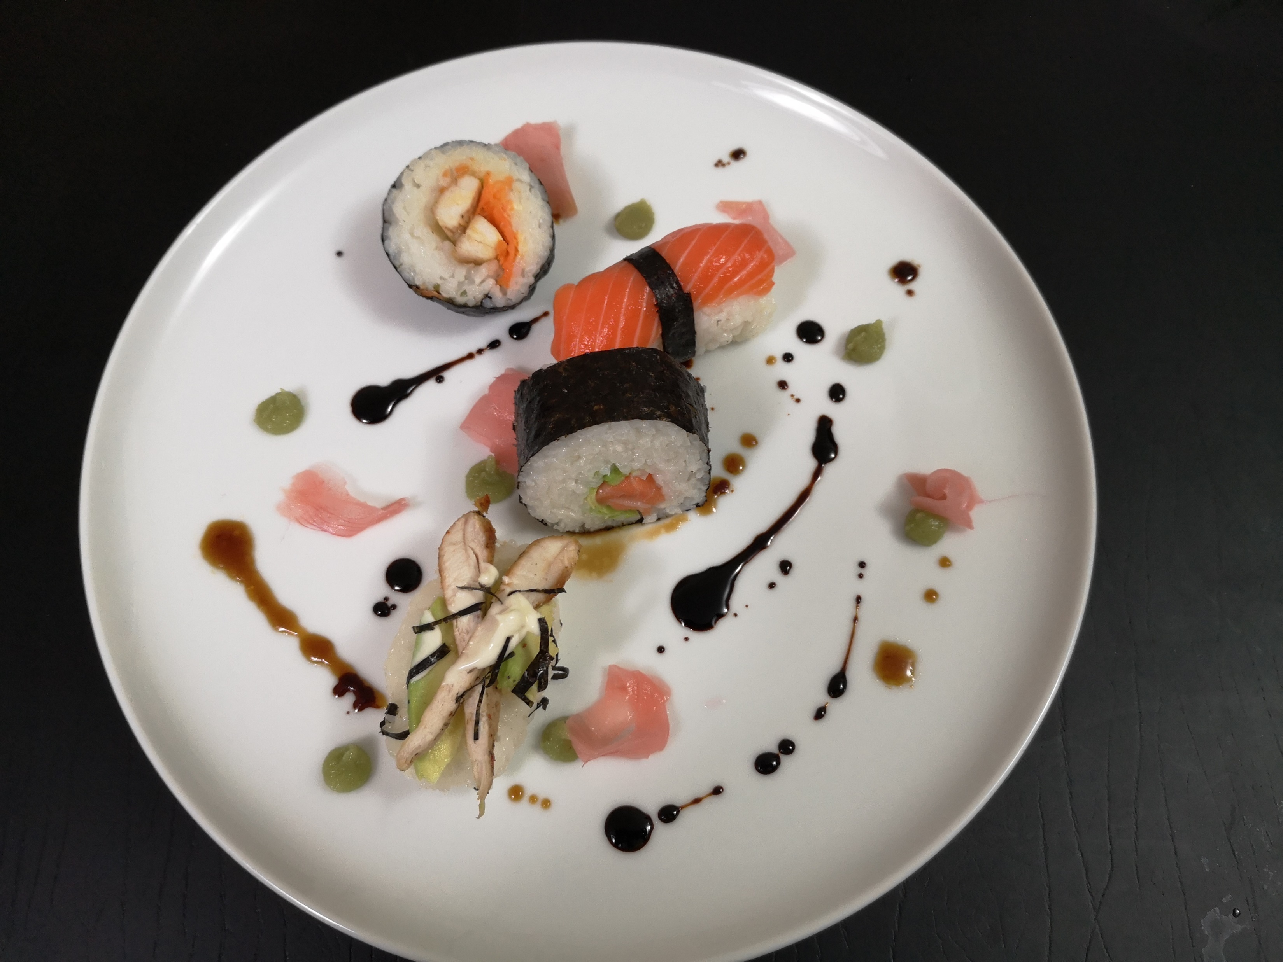
Buffet 5
Bread
Assorted rustic breads with butter
Cold Station
Green salad with herb dressing (GF/DF)
Whole poached salmon with cocktail sauce
Cobb salad (GF)
Hot Station
Herb & garlic marinated beef scotch fillet with red wine Jus (GF/DF)
Sage and onion roast chicken with brie cheese sauce (GF/DF)
Creamy mushroom risotto (GF)
Parsley potato (GF/DF)
Garden Fresh Vegetables. (GF/DF)
Dessert
Creative Assorted Dessert Buffet with
Fresh seasonal fruit (V, GF, DF)
Carvery Station - $9.00 pp per meat
Roast ham
Roast beef
Roast pork
Includes condiments:
Mustard, apple sauce, horseradish cream, Yorkshire pudding
Includes selection of teas, herbal infusions & Ebony roastery coffee
$85.00 pp

Slide 24
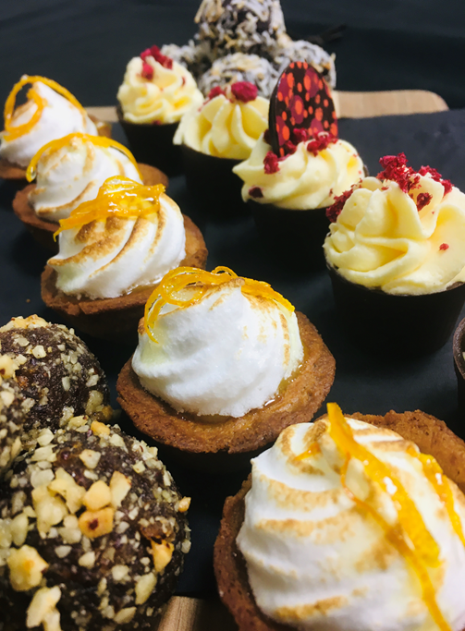
Banquet Menu 1
~A banquet is served platter style to each table ~
To start…
Homemade potato bread with chili garlic butter
Mixed variety of canapes
Chef Choice of mixed choice canapes
Salad
Green garden salad with herb & ginger dressing (GF/DF/V)
Mains
Chicken thighs tossed through a mango sauce with green bean, jasmine rice, garlic yoghurt & crispy roti
Scotch fillet with Creamy cauliflower puree, garlic & herb charred broccoli & roasted Portobello mushroom.
Served with roast potato (GF)
Dessert
Chocolate pudding with brandy butter sauce
Chefs' selection of sweet canapes
Includes selection of teas, herbal infusions & Ebony roastery coffee station
$70.00 pp

Slide 25
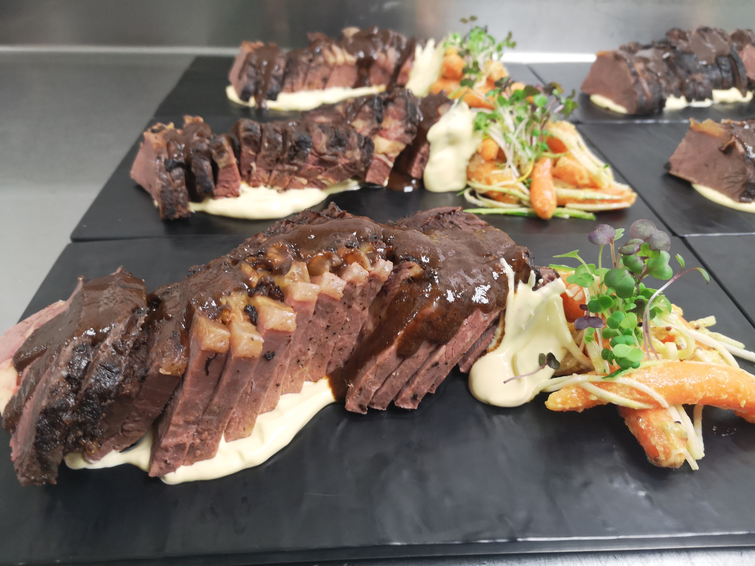
Banquet Menu 2
To start…
Homemade potato bread with chili garlic butter
Deli antipasto platter
Salad
Pasta Salad
Green garden salad with herb & ginger dressing (GF/DF/V)
Mains
Fennel and sage roasted pork with roasted pumpkin and kumara with fennel gravy (GF/DF)
Slow cook beef cheek wrapped with bacon with
garlic potato mash, juniper berry & herb jus. (GF)
Dessert
New York cheesecake with berry compote
Chefs' selection of sweet canapes
Includes selection of teas, herbal infusions & Ebony roastery coffee station
$75.00 pp

Slide 26
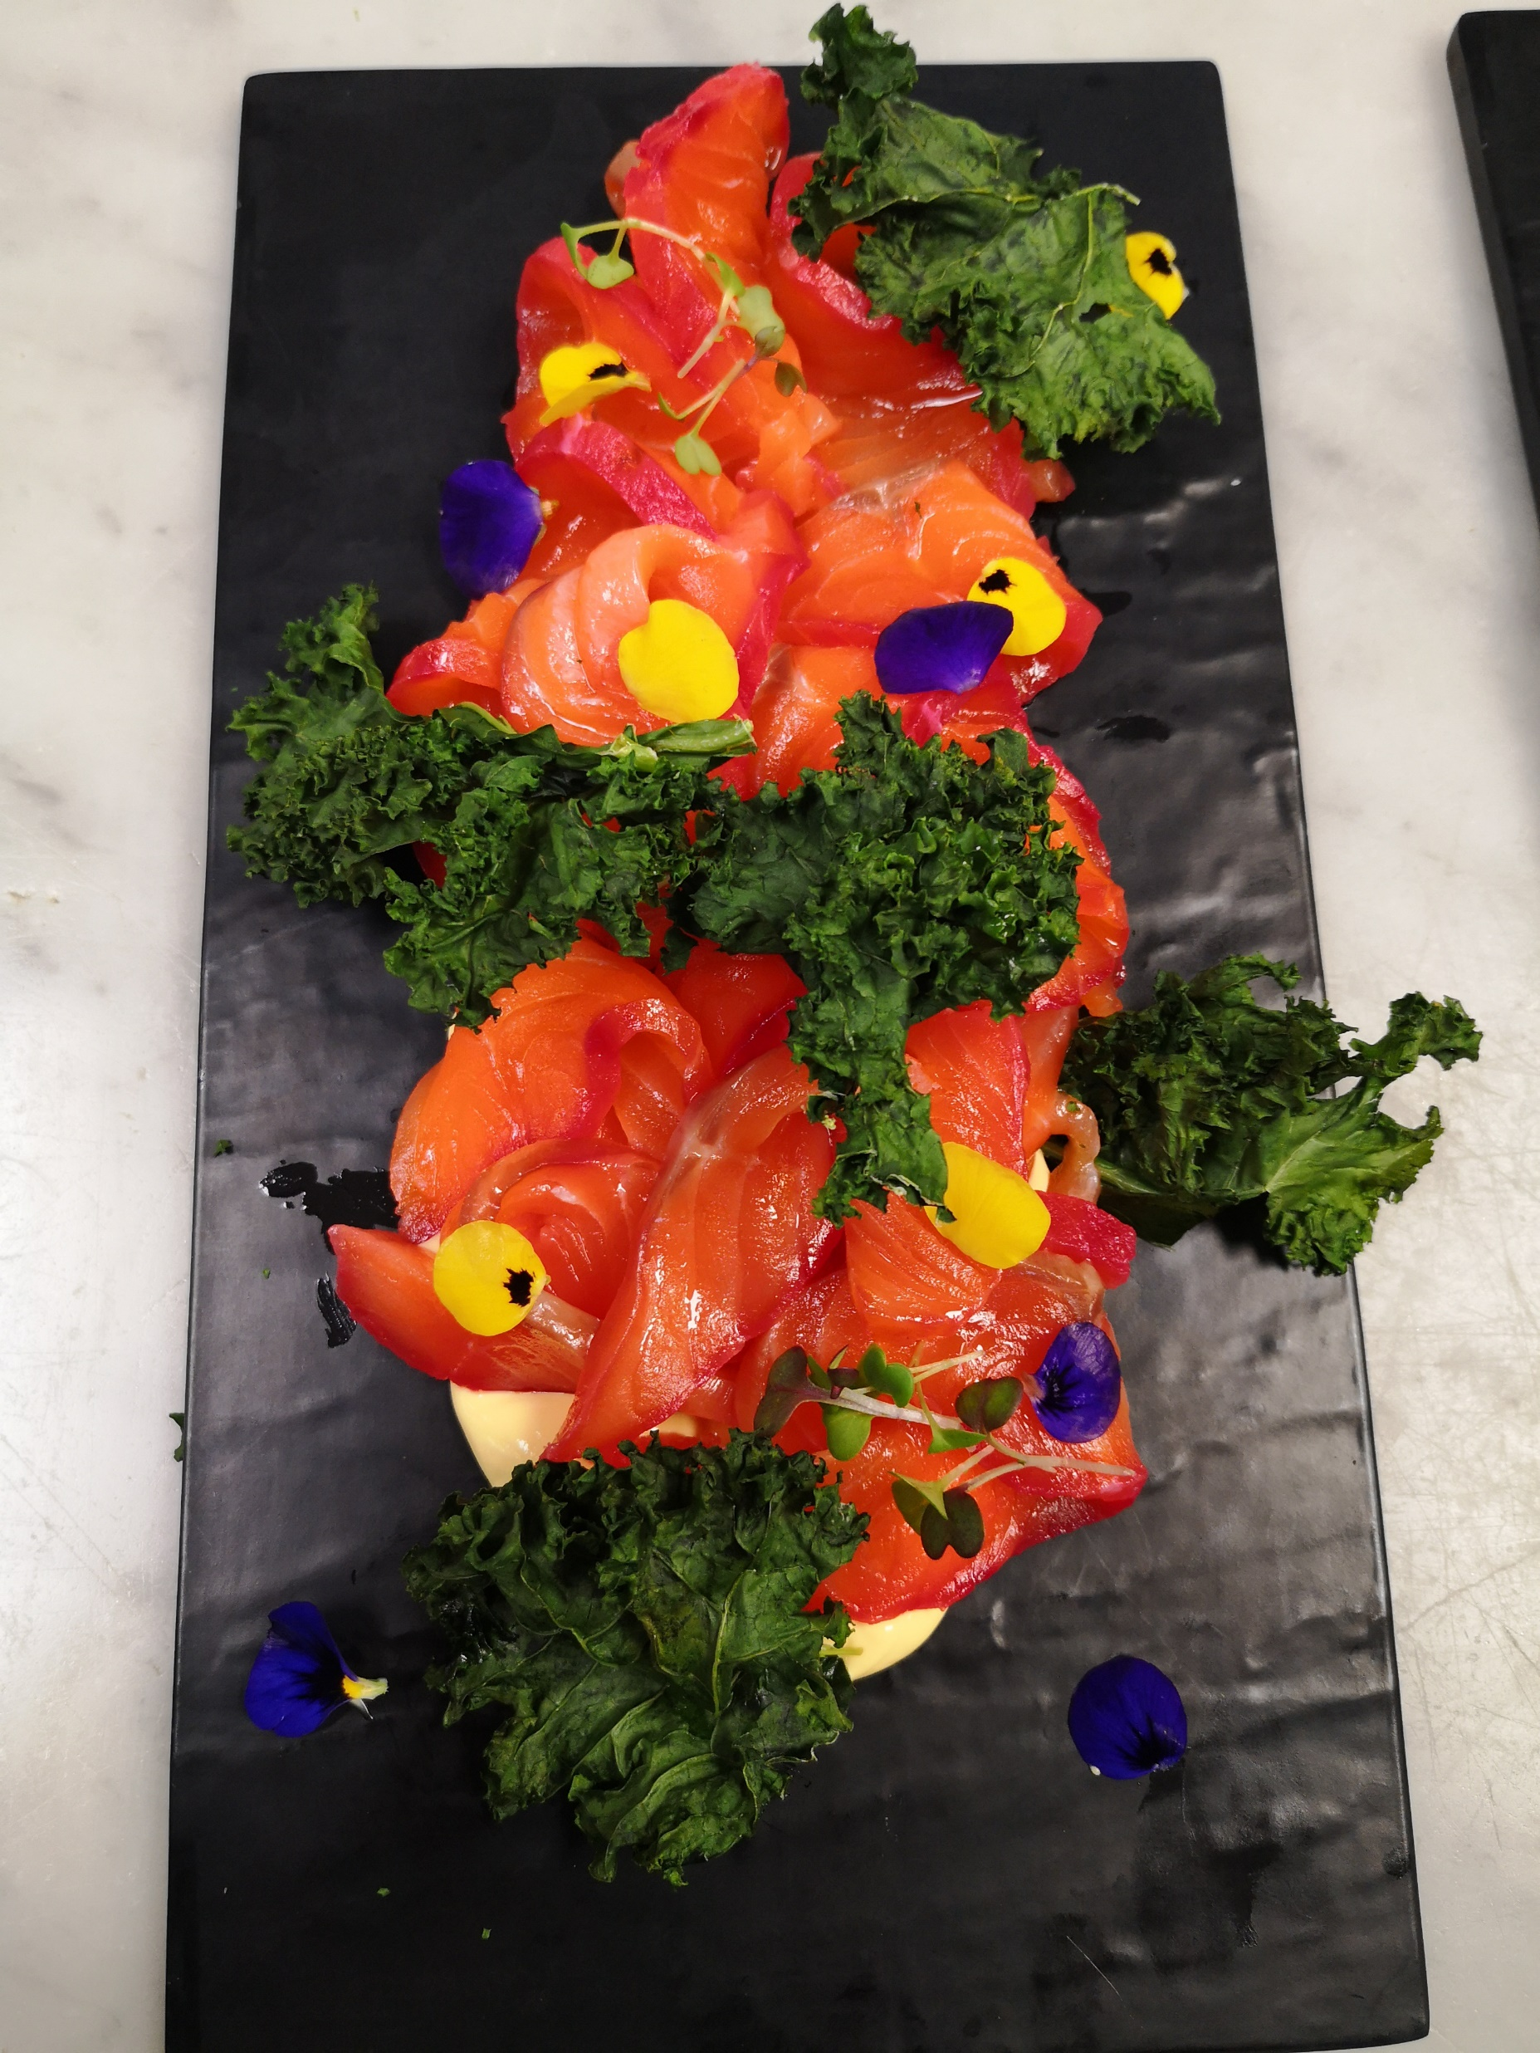
Banquet Menu 3
To start…
Homemade potato bread with chili garlic butter
Chefs’ selection of canapes
Deli antipasto platter
Salad
Broccoli tuna salad (GF/DF)
Green garden salad with herb & ginger dressing (GF/DF/V)
Roast carrot salad with orange dressing (GF/DF)
Mains
Moroccan style lamb with couscous, mix nut & aubergine pickle
Lemon and herb marinated king salmon with sautéed green and potato, with herb sauce (GF)
Cajun season roast chicken with confit garlic and parsley Tossed potato with gravy (GF/DF)
Dessert
Chocolate and blueberry mousse
Pavlova with fruit & vanilla cream (GF)
Chefs' selection of sweet canapes
Includes selection of teas, herbal infusions & Ebony roastery coffee station
$85.00 pp

Slide 27
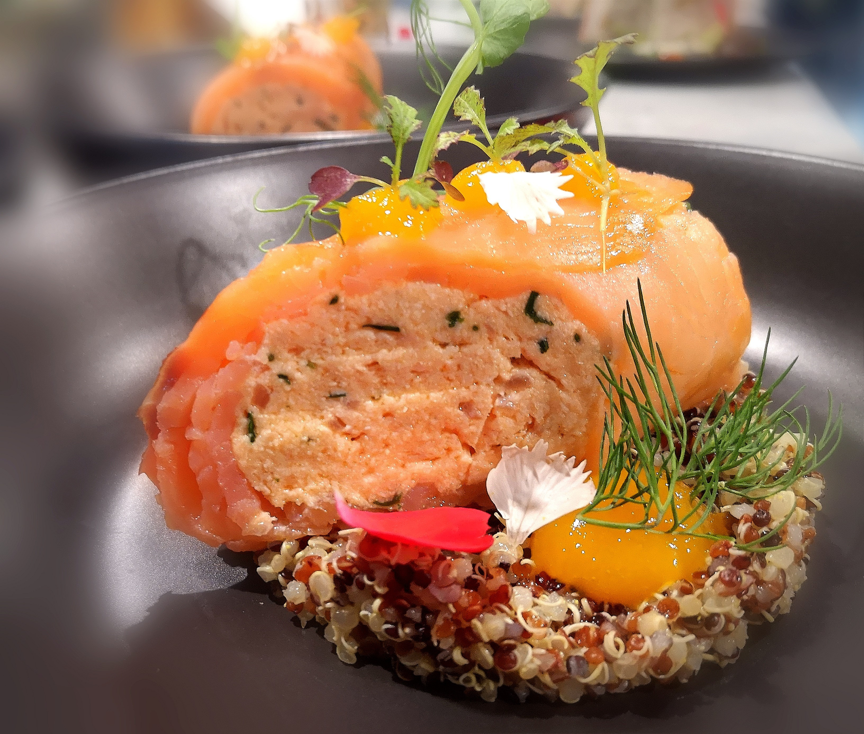
Plated dinner
Pre-set on tables
Assorted rustic breads with butter
Entrée (choose 1 option)
Pickled crab & salmon terrine
With salmon caviar, cream fraiche & gremolata oil
Wild cake
Wild mushroom pan cake served with truffle cream pasta herb salad (V)
Goat cheese strudel
Goat cheese and red onion marmalade strudel served with salsa verse & ratatouille (V)
Dukkha Spiced Venison
Beetroot terrine, carrot velouté with black garlic puree (GF)
Beef Tartare
Dijon cream fraiche, egg and herb salad, pickled vegetables with homemade chips (GF)
Confit Duck
Herb confit duck, savoury lentil cake, yoghurt sponge with orange curd & spinach jelly
Salmon Gravlax
Savoury almond biscuits, herb cream fraiche, micro green salad with capers & pickled orange
Grilled Halloumi
Pickled beetroot, fennel salad, quinoa salad, capers, and raisin chilli chutney (V)
Mains on the next page….
Special dietaries catered to on request

Slide 28
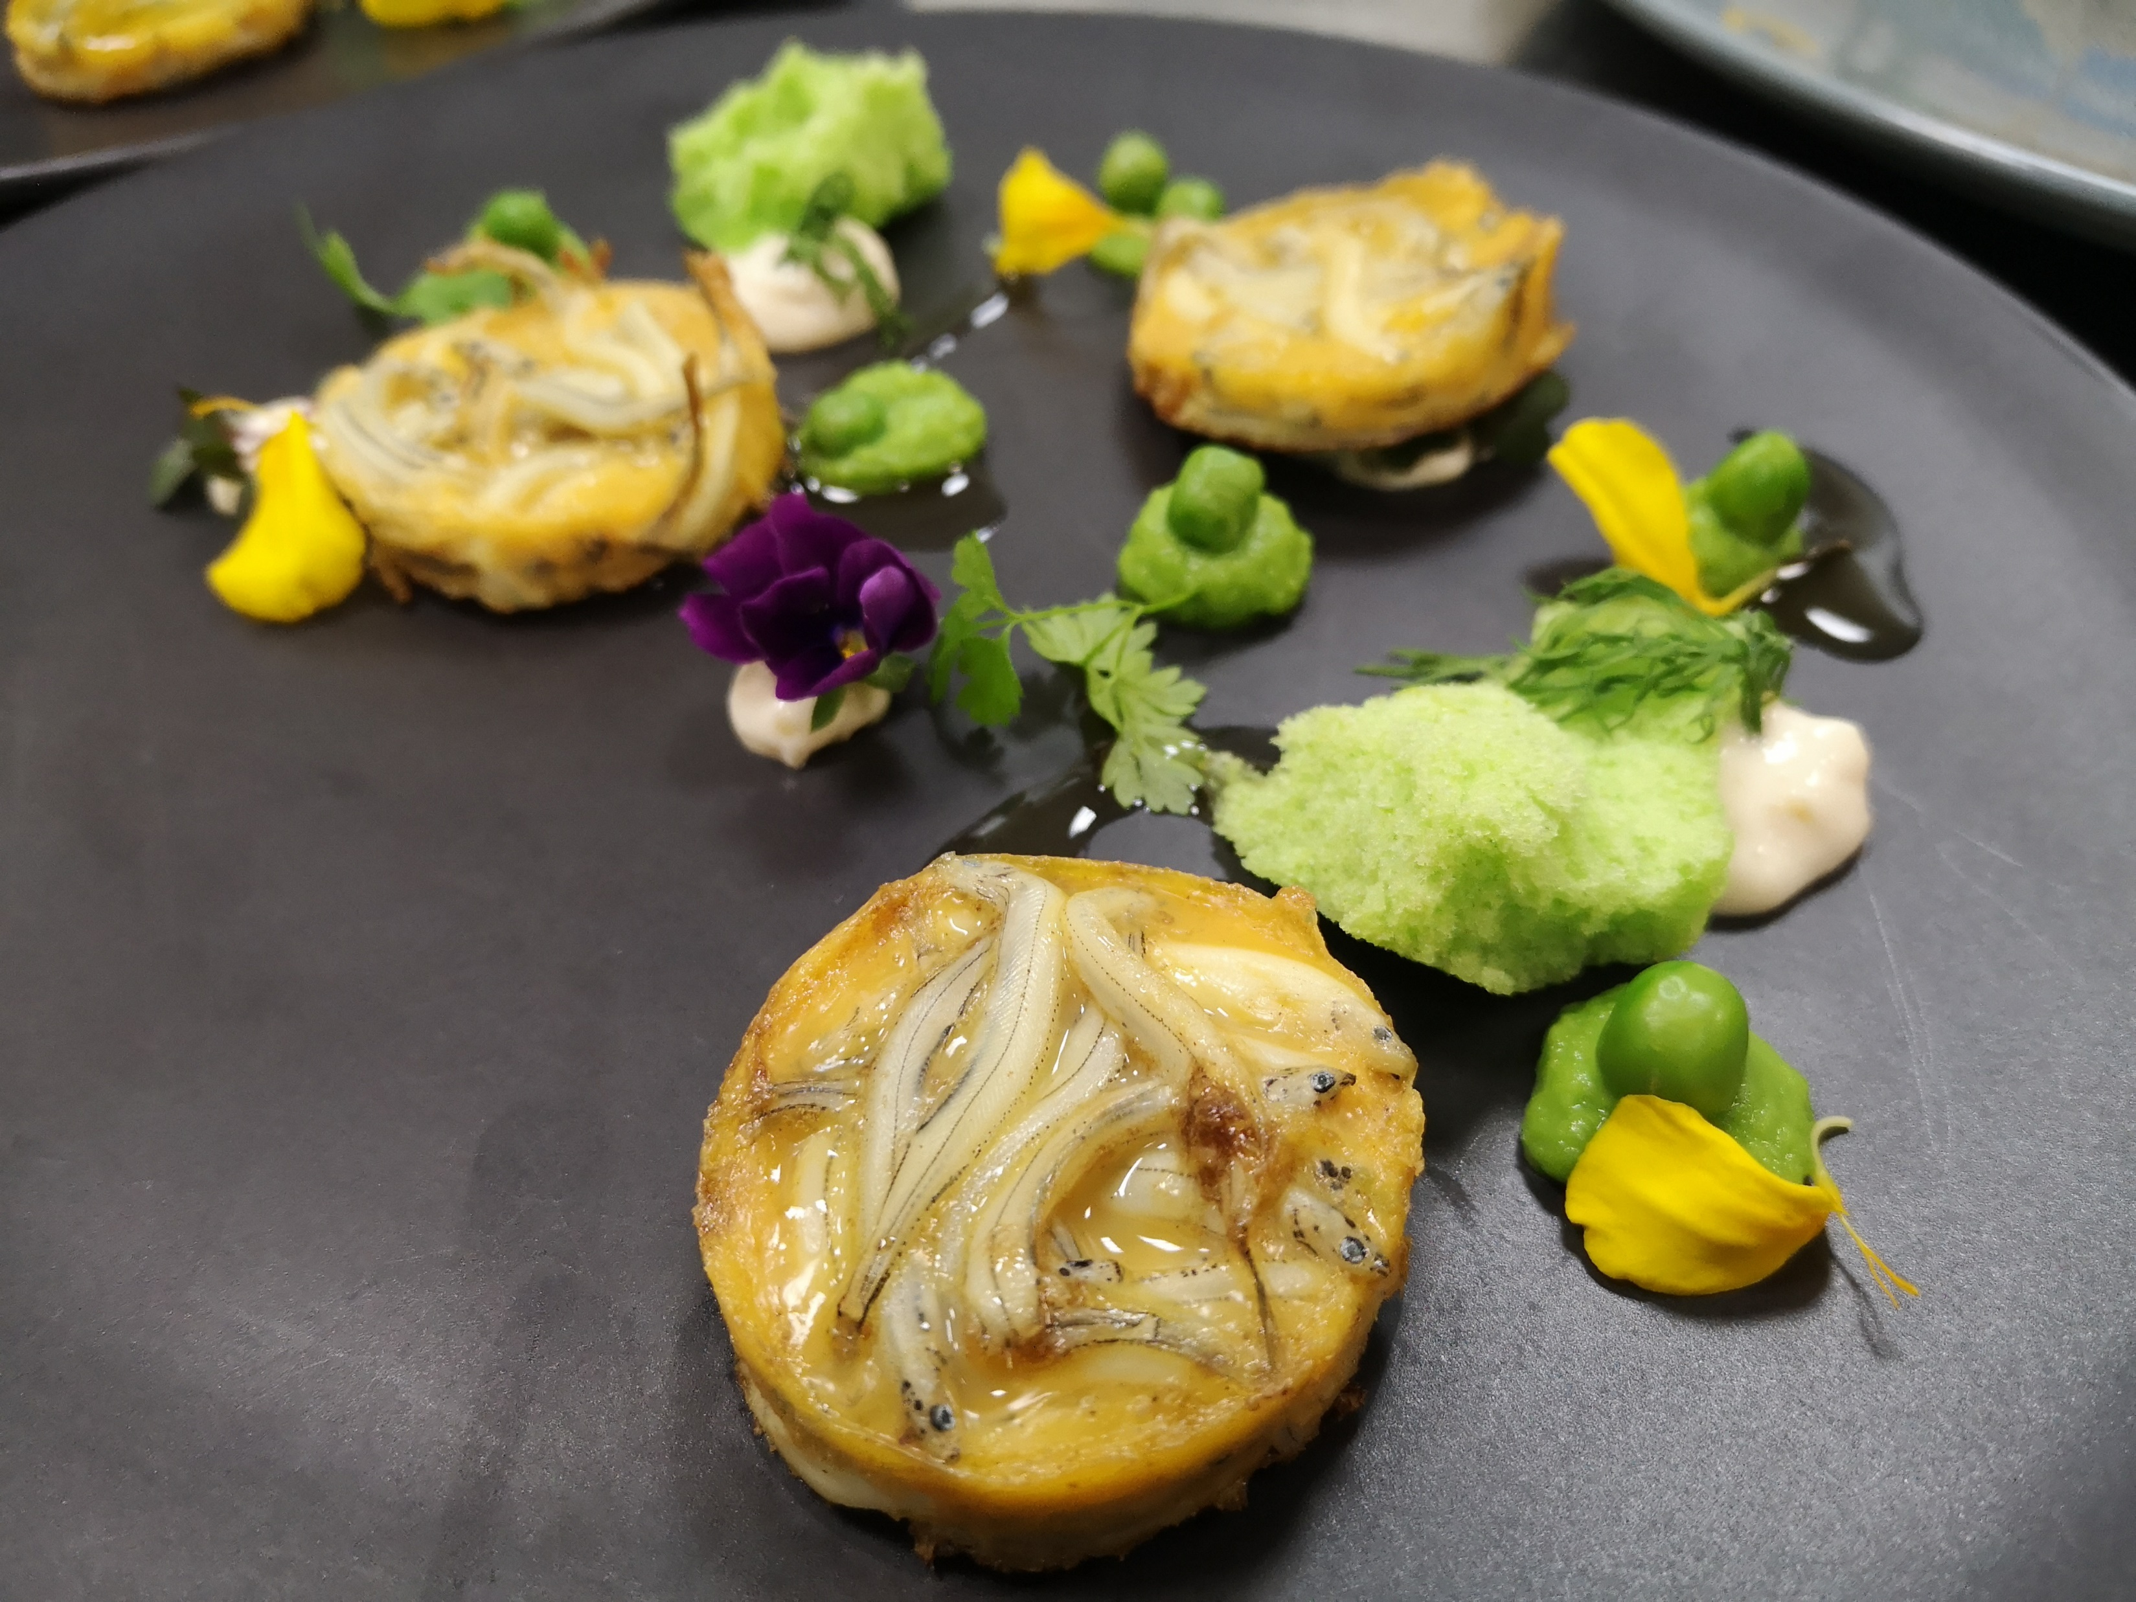
Plated dinner
Main (choose 2 options for alternate drop)
Seared fillet of central country beef
Served with smoked Portobello, potato gratin port wine jus (GF)
Paprika & red wine confit chicken
Potato fondant filled with goat cheese, sautéed mushroom and kale with herb jus
Surf and turf
New Zealand grass feed beef eye fillet and prawns Mascarpone potato & mushroom duxelles, Guinness jus
Roast pork
Fennel roast pork with pumpkin mash & Quinoa salad with white wine jus
Grilled king salmon
Garlic confit potato, lemon and dill sauce steamed broccolini (GF)
Gnocchi
Gnocchi with sautéed spinach Burn butter sauce (V)
Ravioli
Ricotta & spinach ravioli with creamy herb sauce (V)
Bolognese
Herb tossed pasta with tempeh Bolognese (V)
Slow Roast Lamb
Braised lamb, bulgur, and wild rice pilaf with eggplant pickle, sautéed spinach & pomegranate sauce (GF/DF)
Chicken Ballotine with Olive and Fig Tapenade
Pommes anna with almond mole and sautéed green beans (GF)
Deserts on the next page….
Special dietaries catered to on request

Slide 29
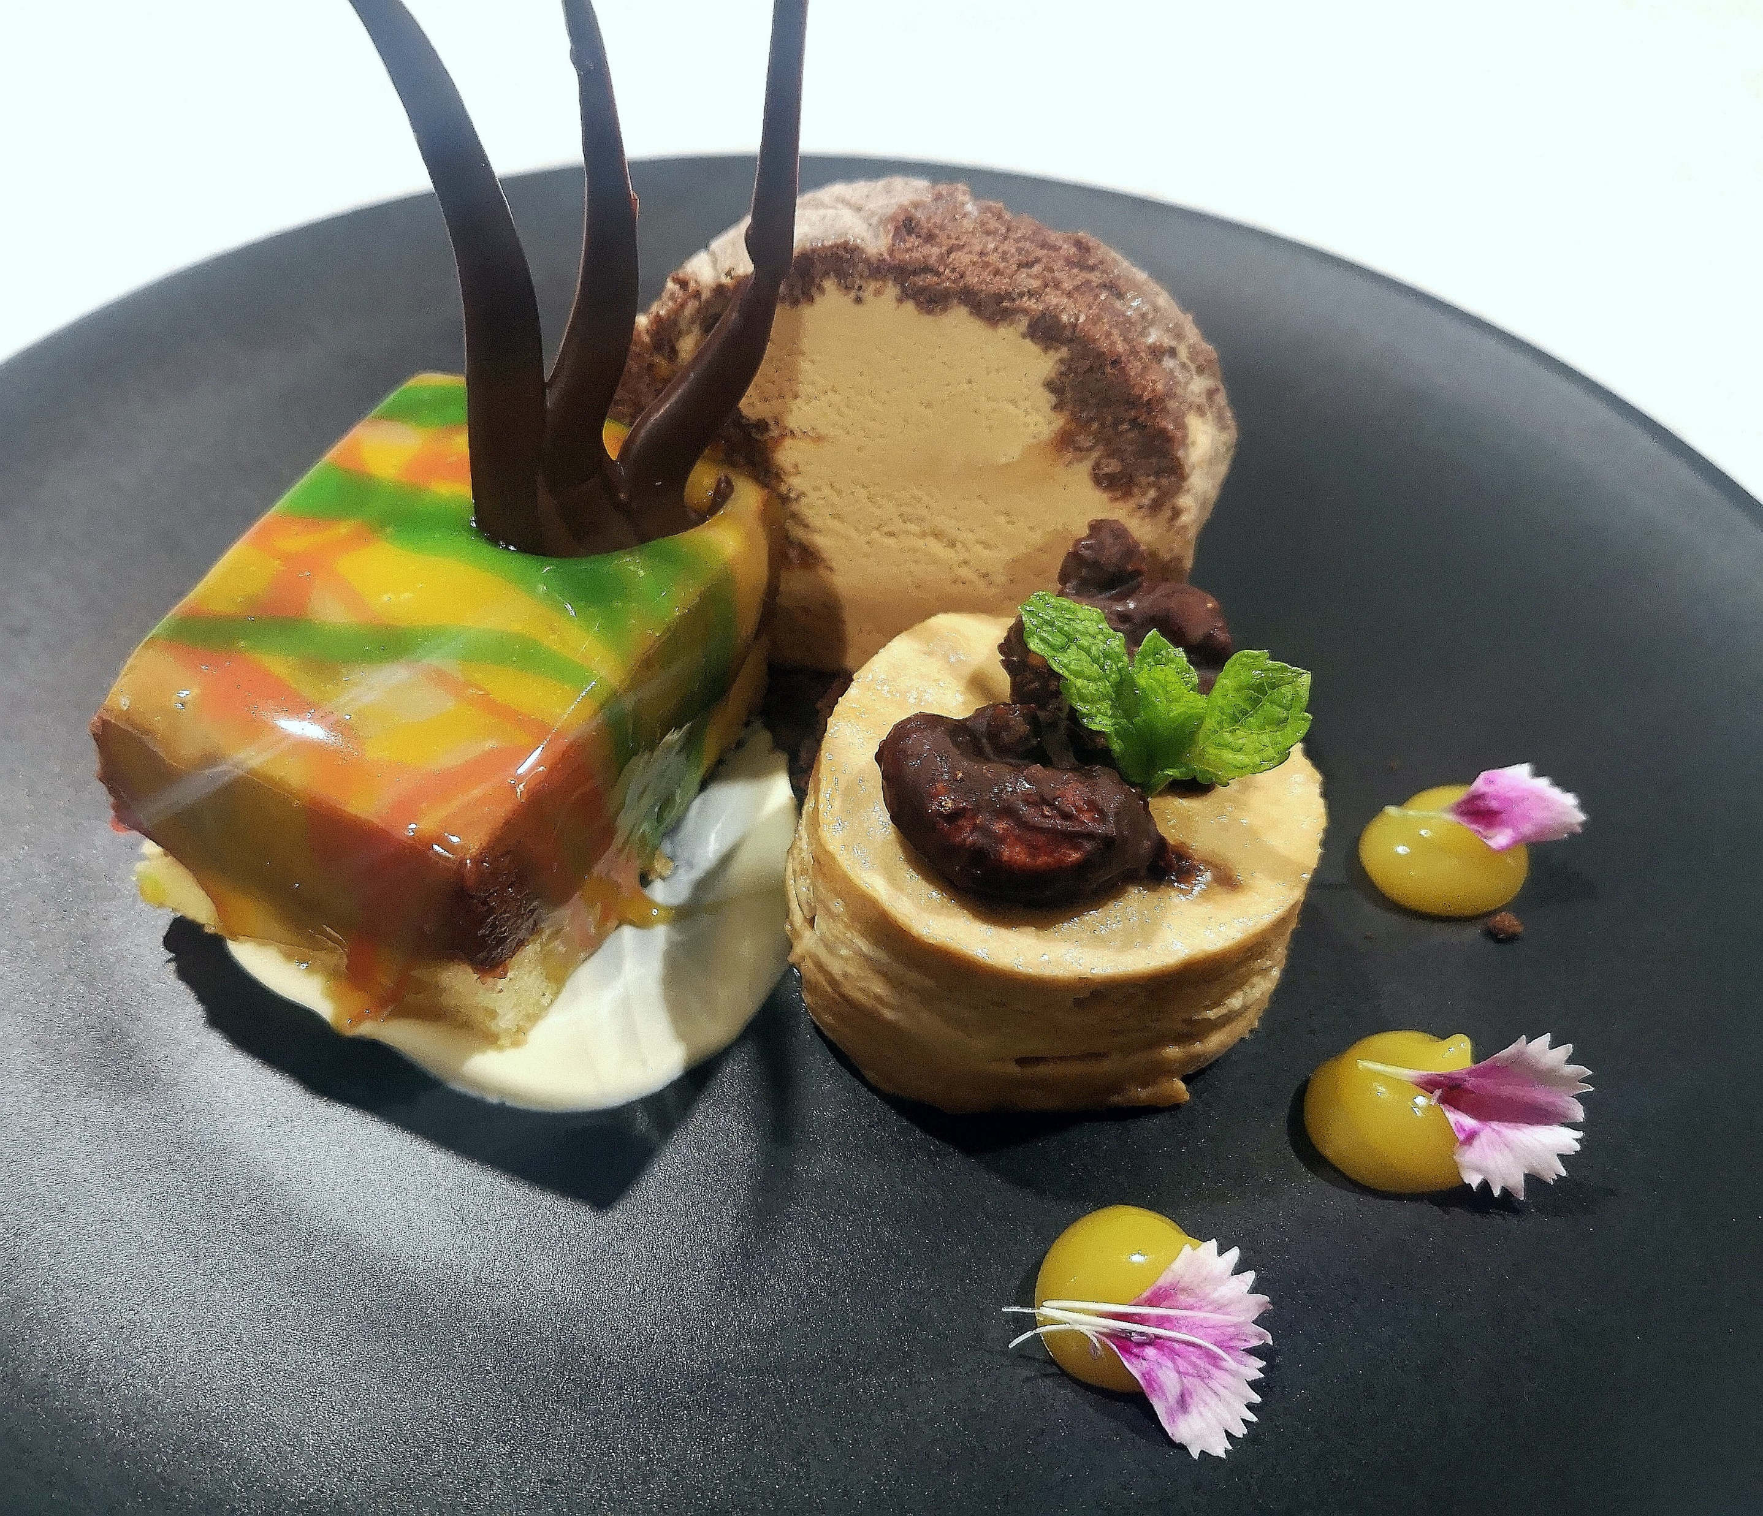
Plated dinner
Desert (choose 2 options for alternate drop)
Chocolate Zuccotti cake
with orange cream & raspberry coulis
Lemon meringue pie
with berry coulis
Domino chocolate cake
with baileys cream sauce
Creamy Butterscotch pudding
with mix nut tuile & espresso cream
Crème brûlée
with mix nut biscotti coffee ice cream
Chocolate mousse tart
with orange jelly, mixed berry comport
Includes selection of teas, herbal infusions & Ebony roastery coffee station
$95.00 pp
Special dietaries catered to on request

Slide 30
Beverages
Sparkling Wine
Willowglen Brut $7.50 Glass $35.00 Bottle
Henkell Trocken Dry Sec $8.00 Glass $40.00 Bottle
Henkell Trocken Rose NV $8.00 Glass $40.00 Bottle
Allan Scott Cecilia Brut NV $60.00 Bottle
Piper Heidsieck Cuvee Brut $85.00 Bottle
Chardonnay
Lake Chalice Nest $8.50 Glass $40.00 Bottle
Allan Scott $9.00 Glass $45.00 Bottle
Sauvignon Blanc
Lake Chalice Nest $8.50 Glass $40.00 Bottle
Allan Scott $9.00 Glass $45.00 Bottle
Pinot Gris
Lake Chalice Nest $8.50 Glass $40.00 Bottle
Allan Scott $9.00 Glass $45.00 Bottle

Slide 31
Beverages
Rose
Lake Chalice Nest $8.50 Glass $40.00 Bottle
Allan Scott $9.00 Glass $45.00 Bottle
Merlot
Lake Chalice Nest $8.50 Glass $40.00 Bottle
Allen Scott $9.00 Glass $45.00 Bottle
Pinot Noir
Lake Chalice Nest $8.50 Glass $40.00 Bottle
Spirits (served in a tall glass)
Single nip $7.00
Double nip $10.00
RTD
Jack Daniels & Cola $10.00
Jim Beam & Cola $10.00
Smirnoff Ice $10.00
Scrape Grace Vodka $10.00

Slide 32
Beverages
Standard Beer $8.00 Bottle
Export Gold, Export low carb, Tui
Zero 0% $8.00 bottle
Heineken Zero
Light 2.5% $8.00 bottle
Heineken light
Premium Beer $9.50 Bottle
Heineken, Export 33
Cider $9.50 Bottle
Monteith’s Crushed Apple
Fizz & Orange Juice
Small glass $2.50
Large glass $4.00
1 Litre carafe $10.00
Other
Punch bowl $60.00
Ginger beer $5.20 Bottle
Lemon lime and bitters $5.20 Bottle
Live + $5.20 Can
Pump water $4.50 Bottle
Kiwi blue water $3.00 bottle
Sparkling grape juice $6.50 Glass $22.50 Bottle

